Slide 1

v1

Slide 2
Using your Web Browser,
Open this URL:
Click on the workshop you’re attending, and find:
1
http://mlhlocal.host/lhd-resources
2
Setup Instructions
The Code Samples
A demo project
A Workshop FAQ
These Workshop Slides
More Learning Resources
Notes:
What to Say:
Tell attendees we are going to check them in for the event
Once attendees check in, they will receive an email with the items listed on the slide
Attendees must check-in to get credit for attending this event
What to Do:
Confirm that everyone has checked in by asking participants to give you a signal when they receive the email.

Slide 3

Our Mission is to Empower Hackers.
65,000+
HACKERS
12,000+
PROJECTS CREATED
3,000+
SCHOOLS
We hope you learn something awesome today!
Find more resources: http://mlh.io/
Notes:
What to Say:
Major League Hacking (MLH) events are meant to bring hackers together so they can learn, build, and share.
Give participants a brief overview of Major League Hacking (MLH).
Tell participants they can learn more at http://mlh.io/
Example Talking Points:
TODO
Through Localhost MLH is rethinking technology education to reflect how hackers actually learn and how fast the industry moves.
Here's some quick facts about MLH:
Each year, MLH supports over 65,000 hackers around the world at events they facilitate
Those students create more than 12,000 amazing projects together
MLH is a global organization that empowers hackers in more than 400 cities and growing every day

Slide 4
What will you learn today?
1
The basics of Node.js and JavaScript Development
2
How to use Visual Studio Code with Git
3
How to Deploy a Web App with Microsoft Azure
Notes:
What to Say:
Explain to participants what they will learn today
Learning is a core part of being a hacker and today they are going to learn something new
What to Do:
Get participants excited about the experience.

Slide 6
What's Web Development?
Web developers design, build, and maintain websites.
Two main categories:
Front End, or Client-Side:
Directly user-interactive website parts
Technologies
HTML: Content
CSS: Layout
Javascript: Interaction
Back End, or Server-Side:
User-hidden functionality.
Basically any language, but mostly Node.js, Ruby and Python
Note:
Full Stack developer: Someone who is familiar with both kinds of development, and can work on a website from start to finish!
Notes:
On the back-end, the language really doesn’t matter. Just use whatever you’re comfortable with or whatever your collaborators are using.

Slide 7
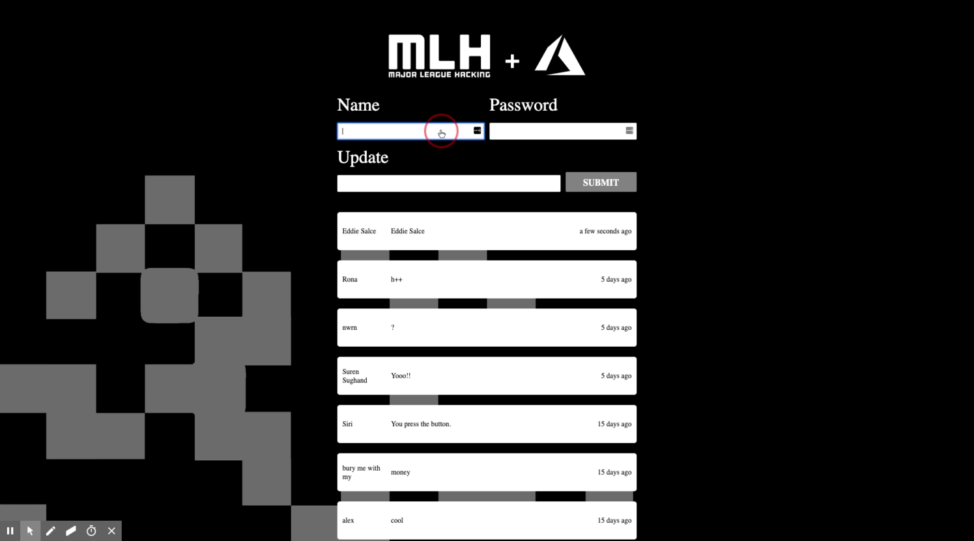
What You'll Be Building
A Hacker Log!

Slide 8


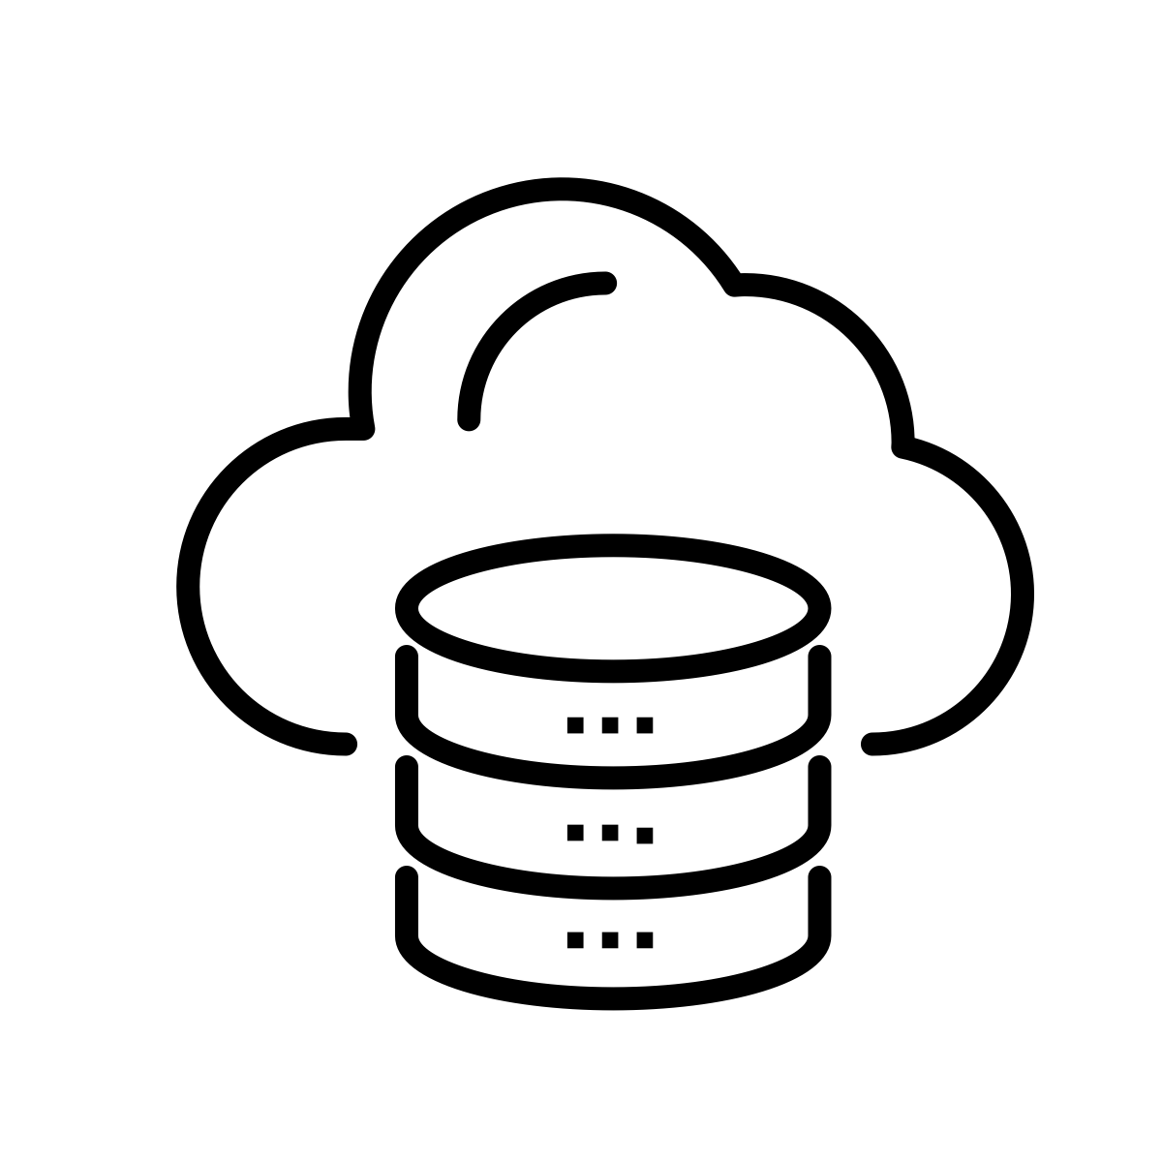
How It Works
1
User types app URL in browser
2
Browser sends request to app's server, which is hosted on Microsoft Azure
Server returns all client-side files for app and browser displays app to user
3
Server Side
(Back End)
Client Side
(Front End)
4
User types update and password
5
Browser sends information back to app
Server checks password and adds updates to database
6
Server updates website with changes now visible to users
7
Database

Slide 9




1
User types app URL
Client Side
(Front-End)
Server Side
(Back-End)
Server returns app pages to display
2
3
User enters password & updates
Server checks password and adds updates to DB
4
Server updates the website with new changes
5
Database

Slide 10

How You'll Build It
We'll be using several tools to make building this app as easy as possible.
Node.js
Express.js
MongoDB and Mongoose
Microsoft Azure
Visual Studio Code
Git

Slide 11
Now that you understand how the app works, let's get started!
We learned that our app will be hosted on Microsoft Azure. Why are we doing that? How will we do that?

Slide 13

Key Advantages of
Microsoft Azure is a cloud platform with more than 100 services and tools for developers.
95% of the Fortune 500 companies run on Azure (and learning these skills can help you land your first job!)
Easily deploy Web Apps, Mobile Apps, Databases, Data Science and AI Apps, Blockchain, Analytics with pre-built configurations
Supports a wide range of
Open source libraries (Node, .NET core, spark, hadoop, kafka)
Programming languages (Python, C#, JavaScript, Java, Ruby)
Operating systems (iOS, Android, Windows, MacOS, Linux)
Notes:
Configuring a server is a uniquely painful experience and one it is well worth paying to avoid.

Slide 14
Please Note: We recommend completing this entire workshop in an Incognito Window in Chrome.

Slide 15
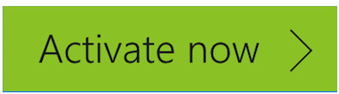

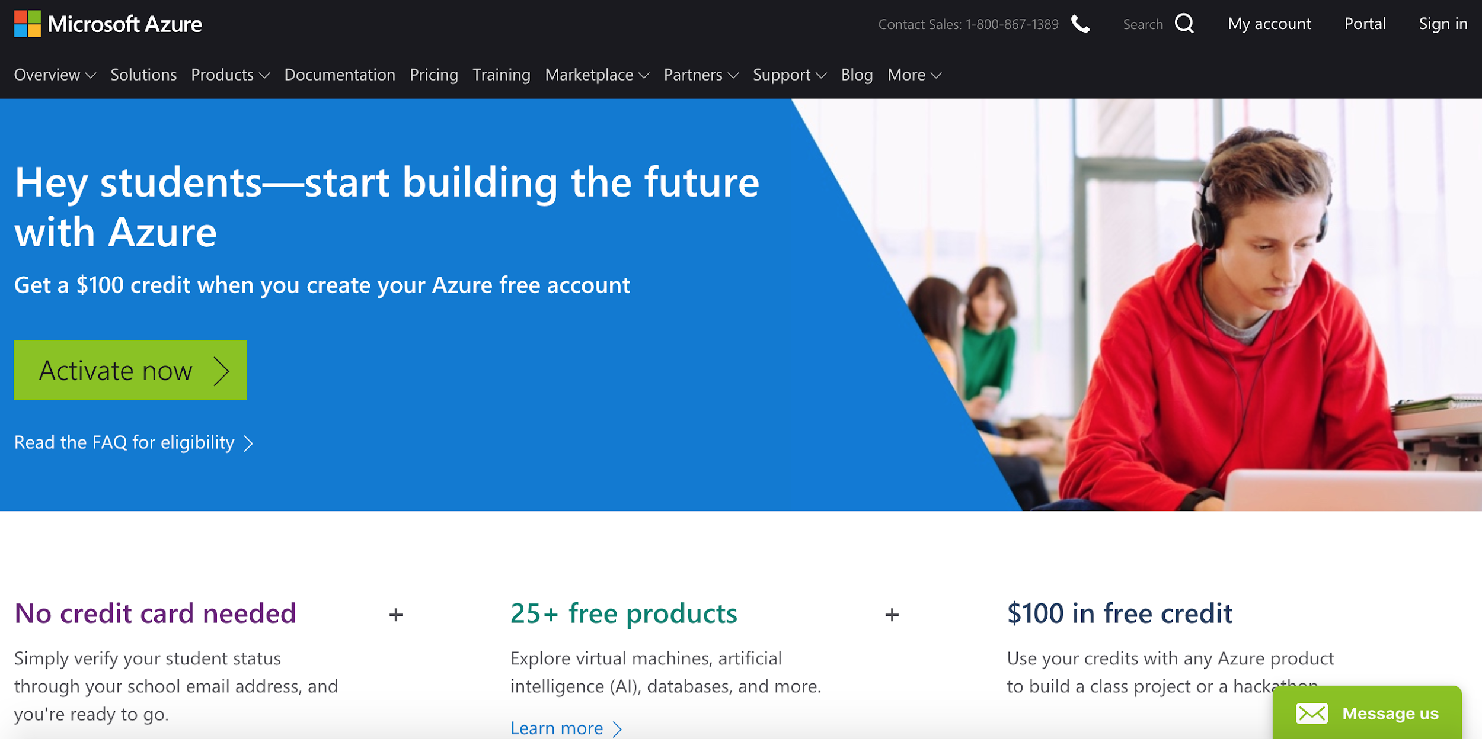
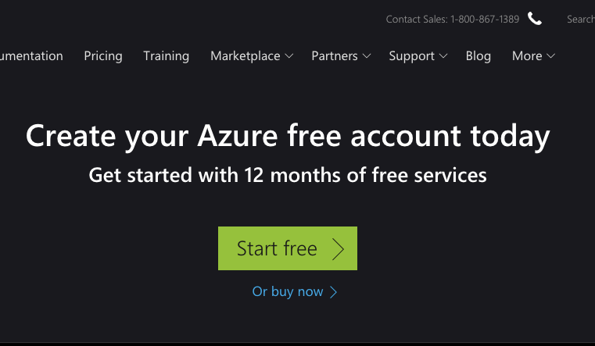
Create Microsoft Azure Account
http://mlhlocal.host/azure-student
http://mlhlocal.host/azure-nonstudent
Navigate to the top URL if you have a student email address and the bottom one if you don't. Select or .

Slide 16
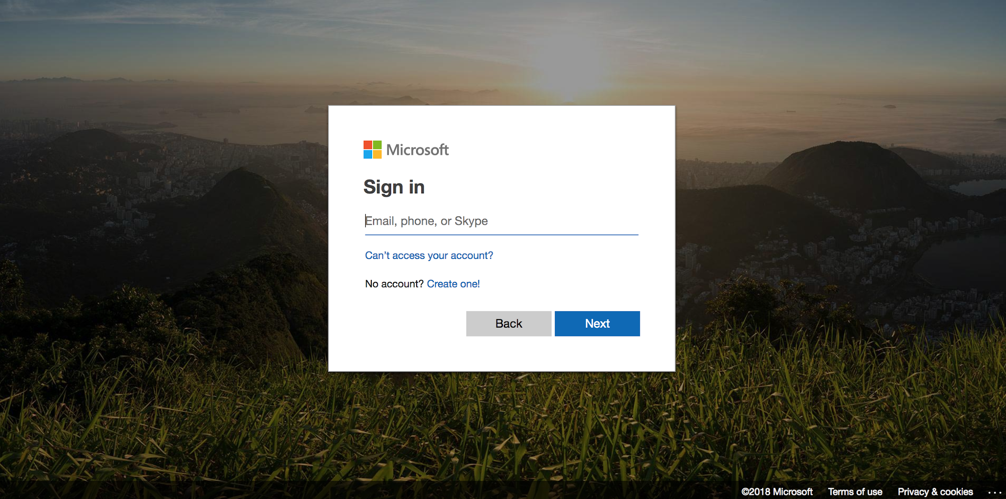
Create Microsoft Azure Account
Log in (or Sign up) with a Microsoft account

Slide 17
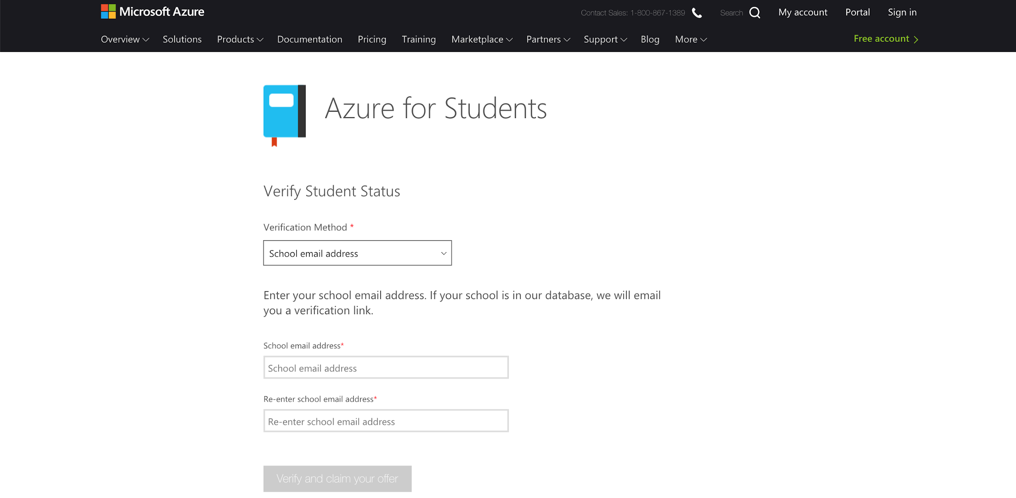
Create Microsoft Azure Account
Enter your school email address (ending in .edu), then follow the verification URL in the email sent to that address.
Choose school email address
Enter school email address

Slide 18
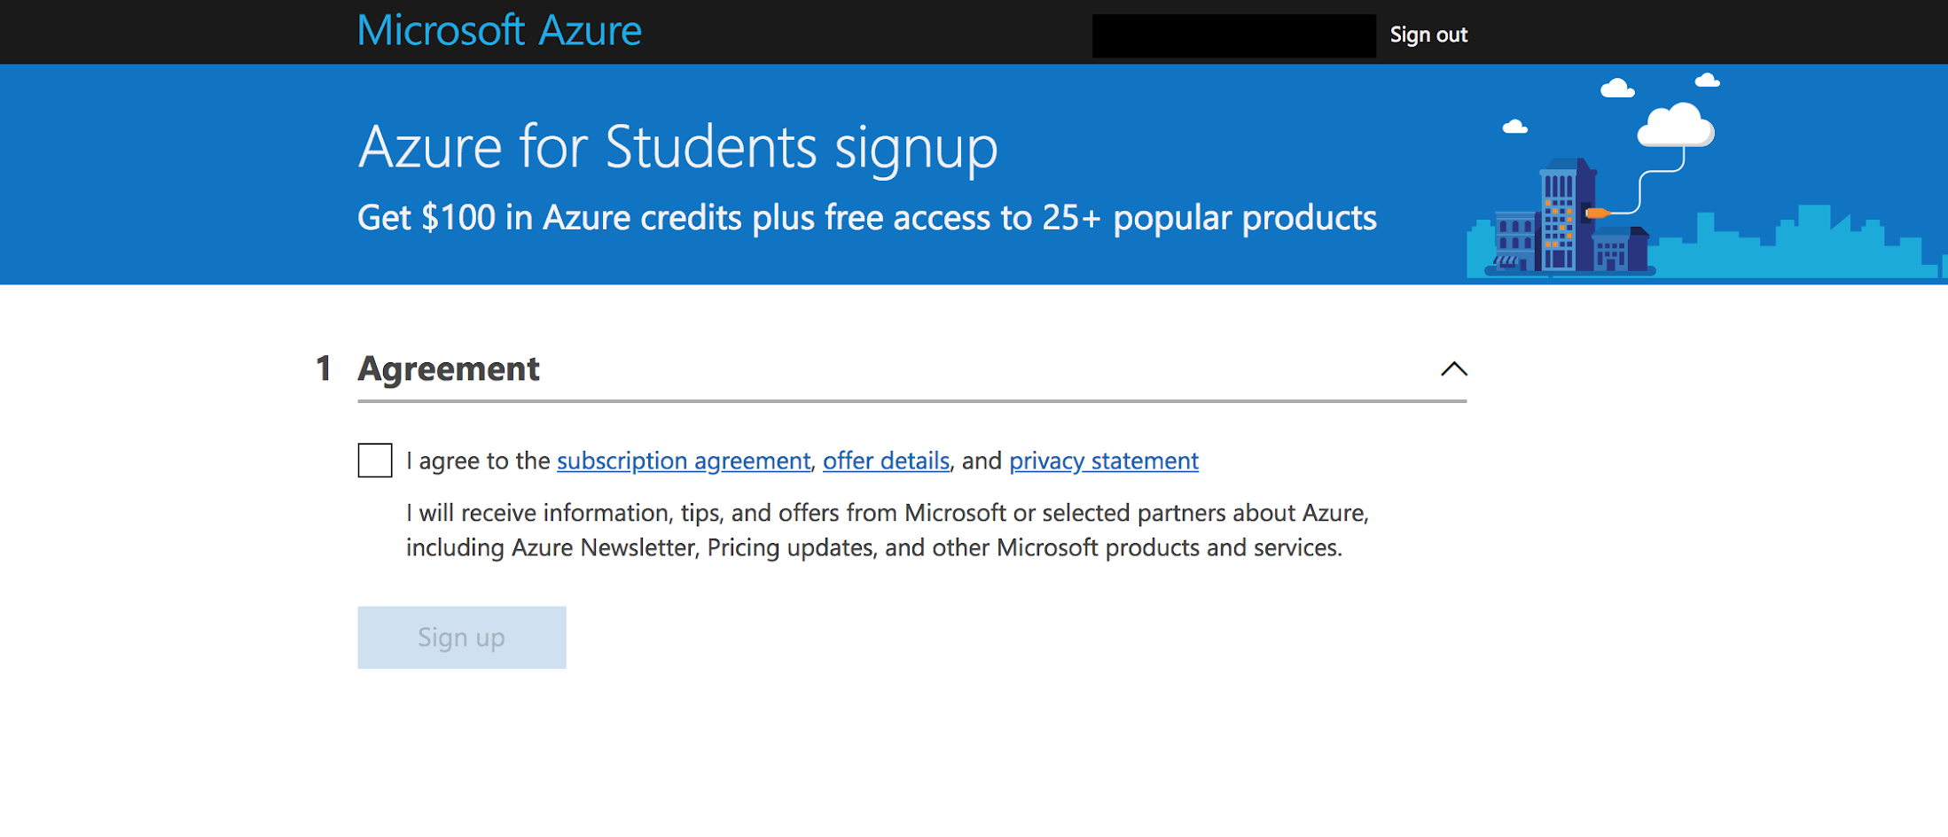
Create Microsoft Azure Account
Accept the terms of service and start using Microsoft Azure!

Slide 19
Microsoft Azure is a cloud platform with awesome developer tools. However, we're not going to write our code on Azure; that's what Visual Studio Code is for!

Slide 20
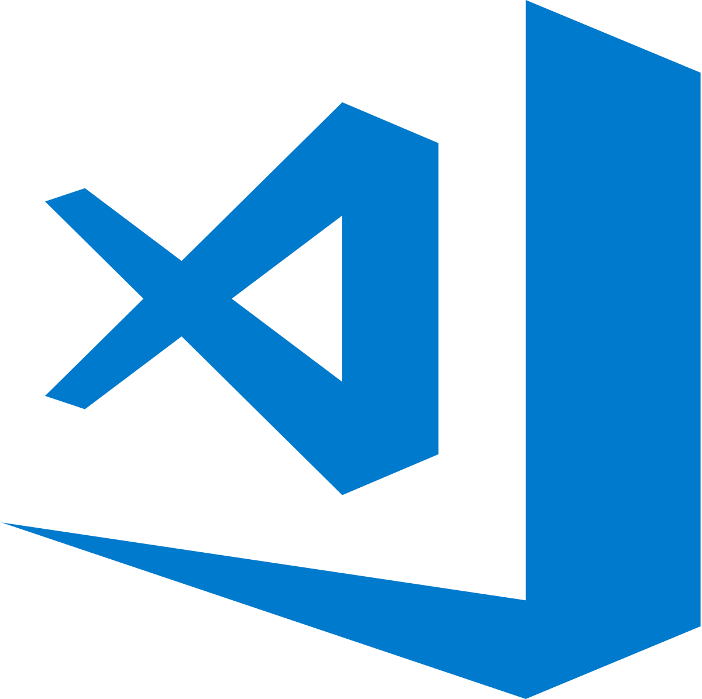
Key Advantages of Visual Studio Code
Visual Studio Code is a simple, code-centric integrated development environment (IDE).
Available for Mac, Linux, and Windows
Key features include debugging, version control with Git, and intelligent code completion
Supports 36 programming languages and offers customized tools and plug-ins to make your dev environment your own!

Slide 21
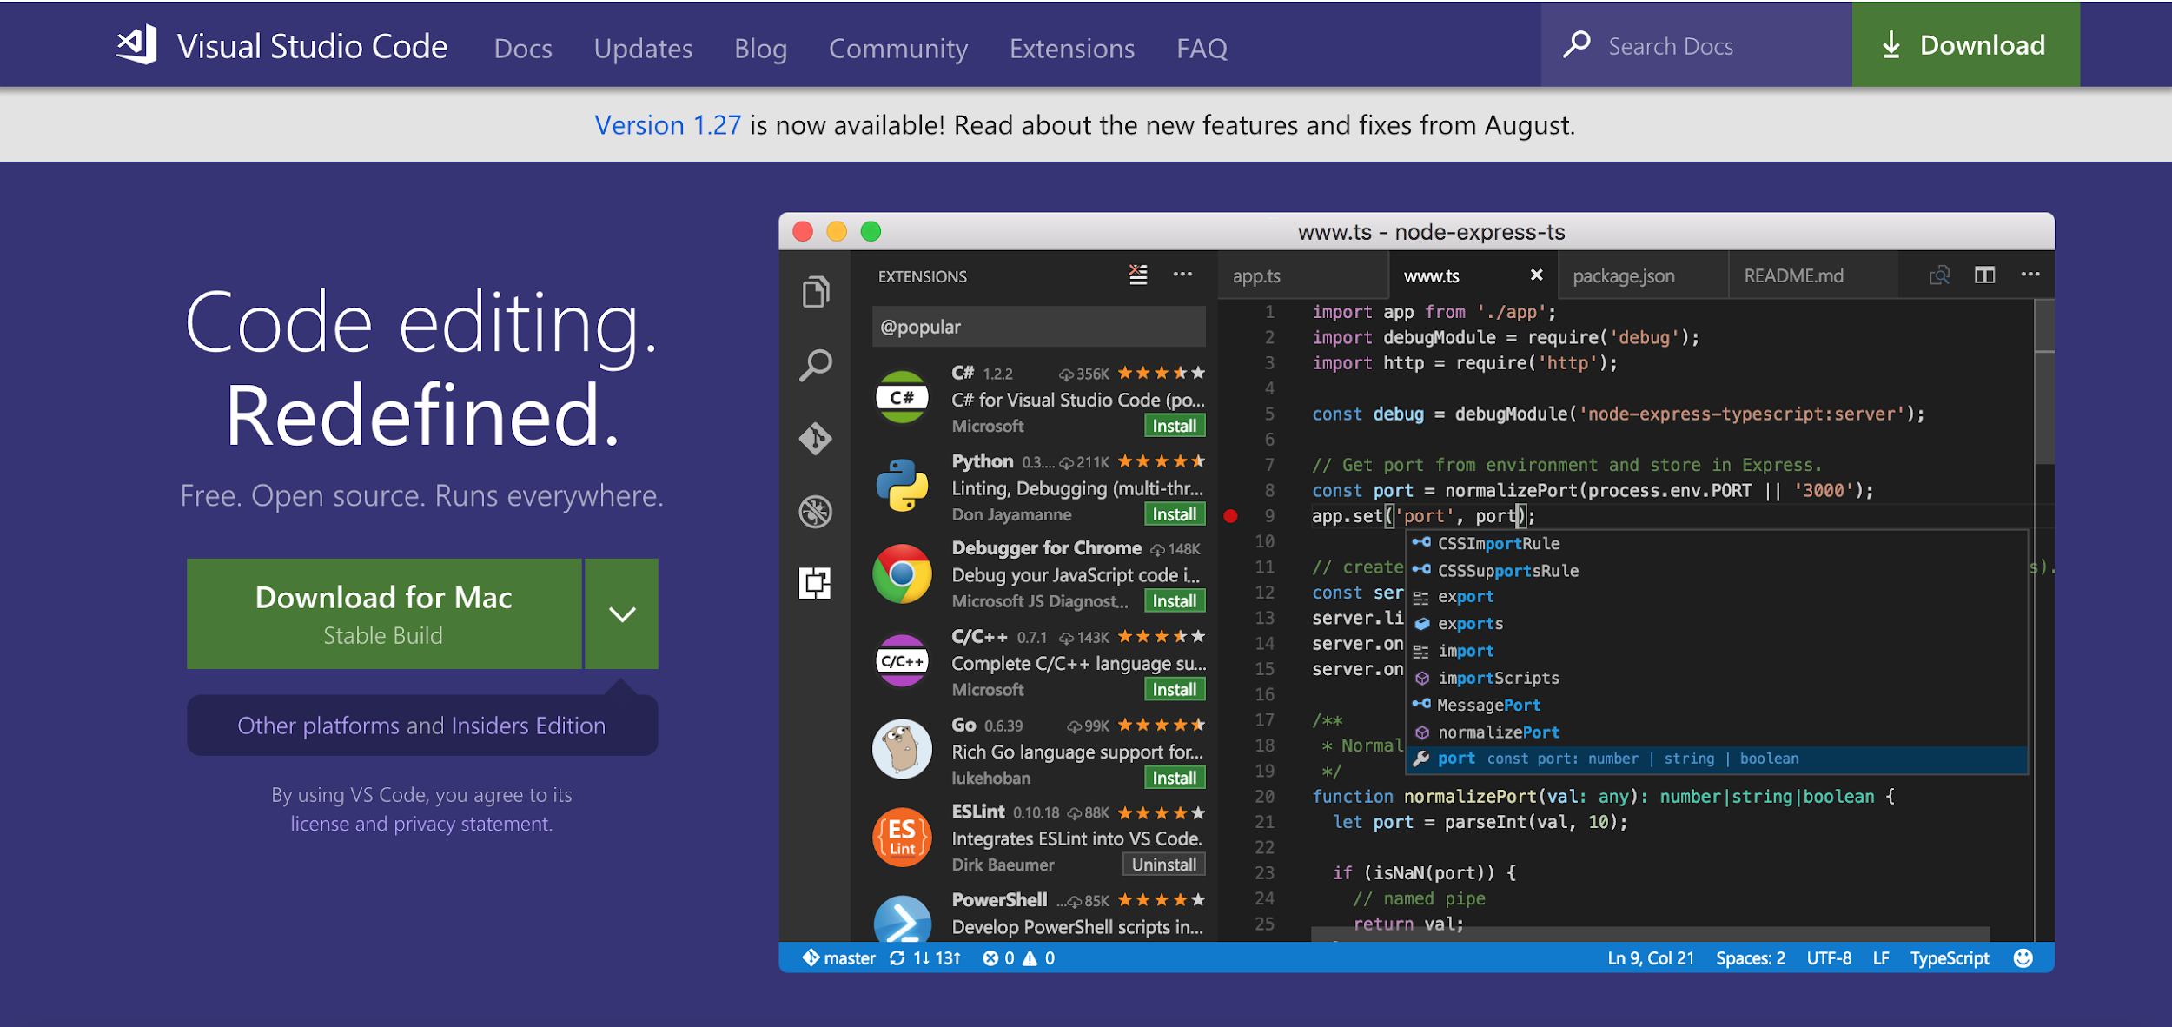
Download Visual Studio Code
http://mlhlocal.host/vscode
Follow the URL and select Download.

Slide 22
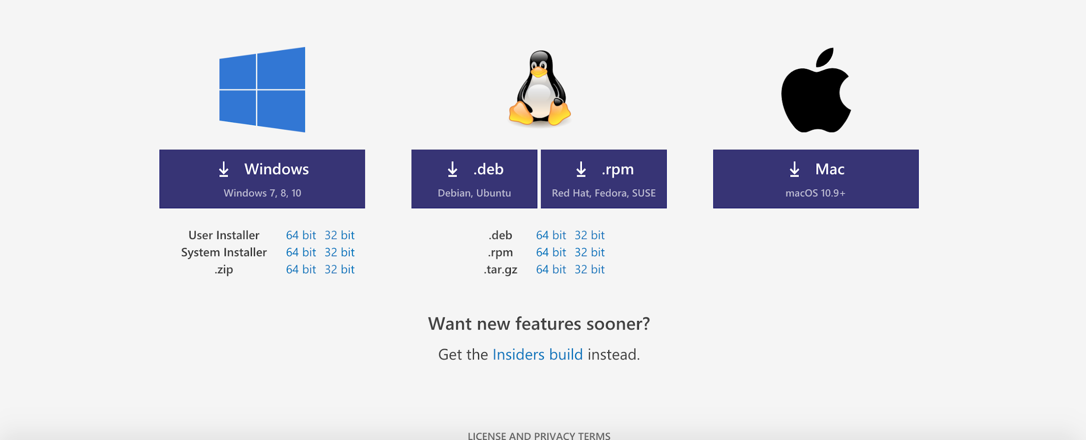
Download Visual Studio Code
(If you're having trouble, scroll to the bottom of the page and manually select the correct package for your system)
For PC
For Mac

Slide 23
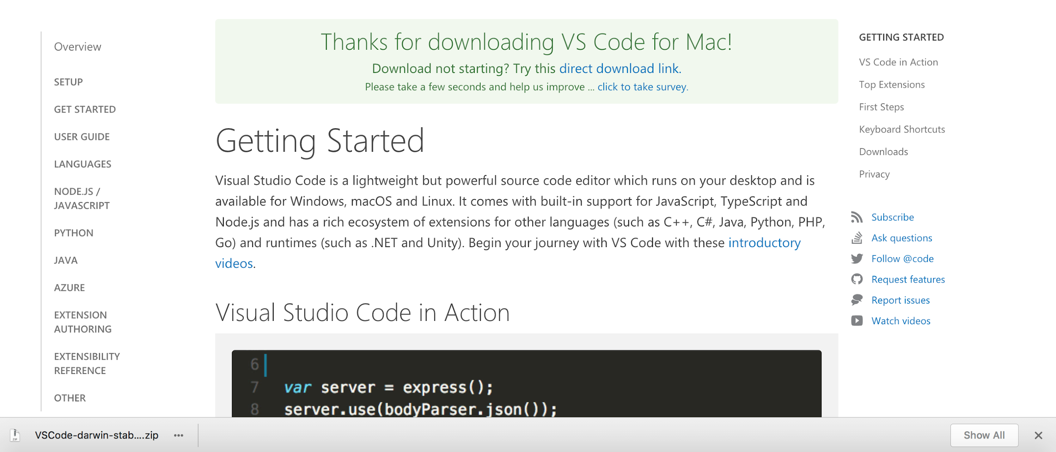
Download and Install Visual Studio Code
Open the VSCode .zip file after it has finished downloading to set up Visual Studio Code.
Your browser may let you open the file directly from the download page...
...or you may have to open your Downloads folder and select the .zip file:

Slide 24
Visual Studio Code has many excellent features such as integrating directly with Git for version control.
Let's get set up with Git!
Notes:
Version control is a way of managing your file changes, without constantly creating copies and renaming your files.

Slide 25
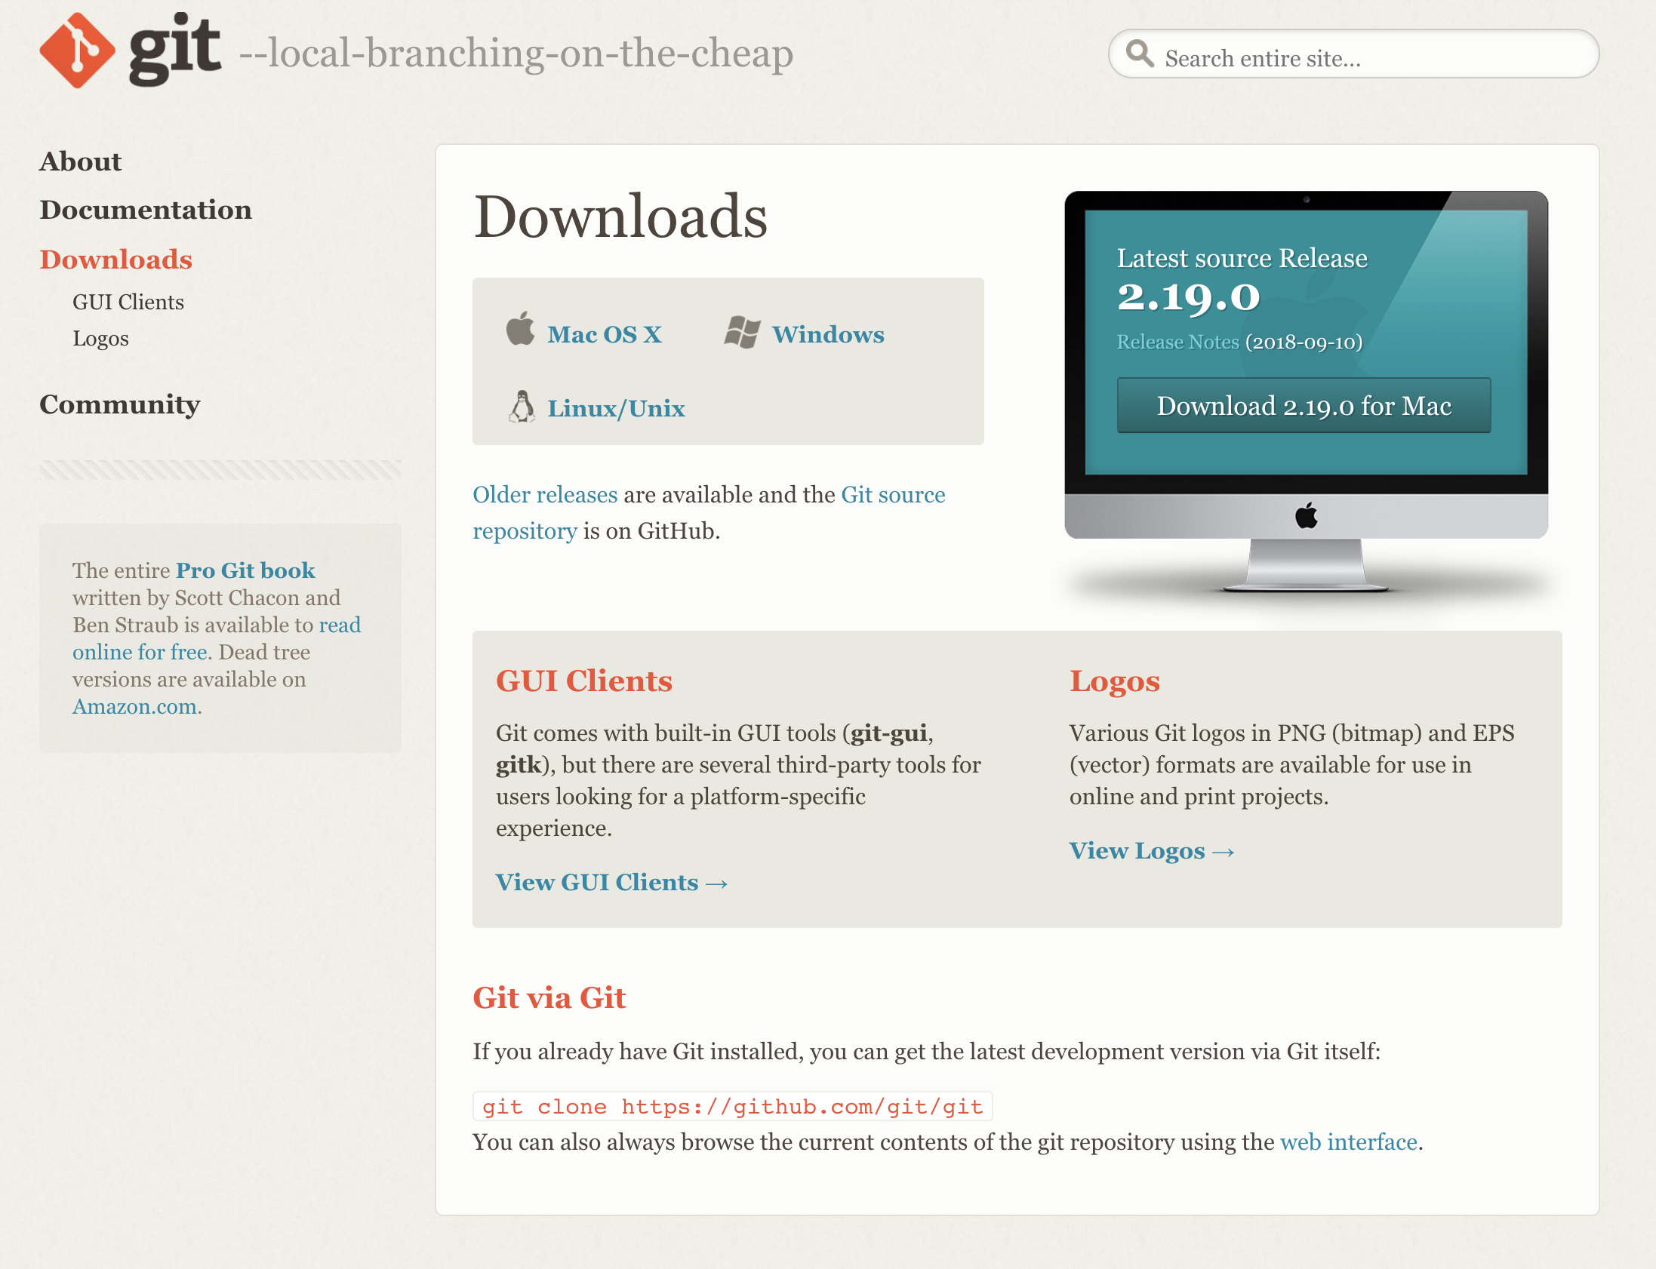
Hello, Git!
Git is a version control system that we'll use to save changes and deploy our app with Azure. We need to install Git!
Visit the URL above.
Select your operating system.
Follow the prompts to install Git!
If Git asks you which default editor to use, we recommend VSCode!
http://mlhlocal.host/install-git

Slide 26
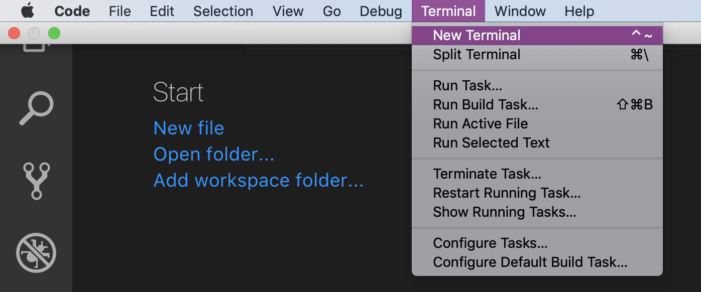
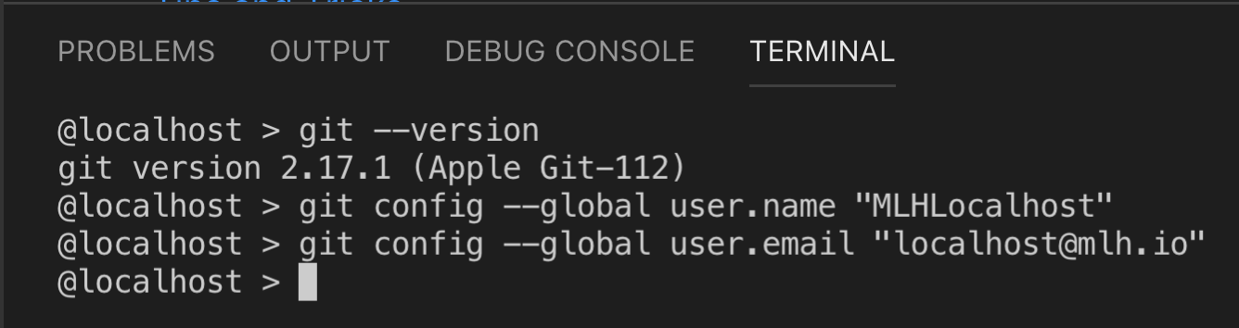
Configure Git Locally
We need to run two commands so Visual Studio Code can use Git.
Open Visual Studio Code.
Open a New Terminal.
Type these commands but substitute your name and email address :
Notes:
A terminal is a way to interact with your computer with typing instead of clicking. It also called a “console” or a “command line” or a “shell”.
This terminal is going to look different if you’re on Windows, but the commands will work the same.

Slide 27
Great! You set up your Azure account, downloaded Visual Studio Code and configured Git!
Now let's get a better understanding of the technologies that our HackerLog app uses.

Slide 29
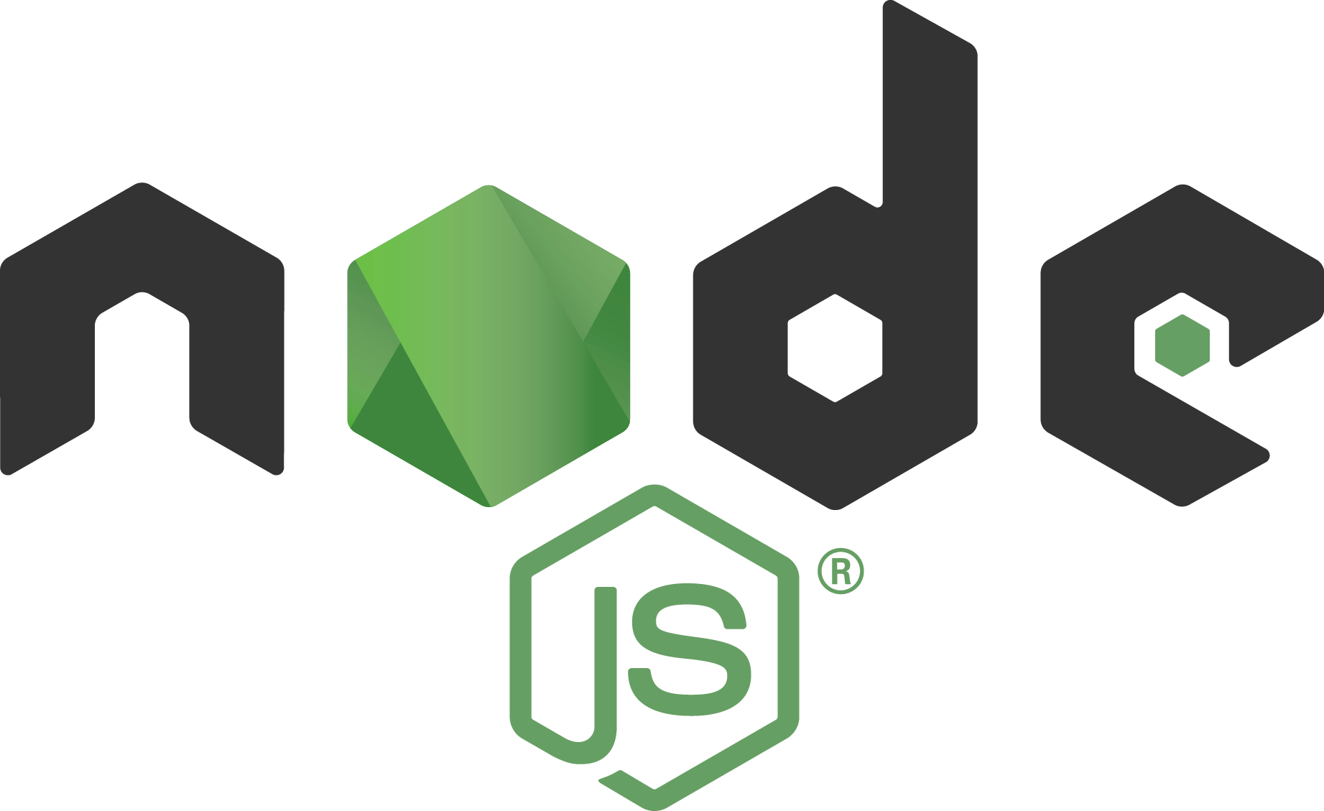
Hello, Node.js!
Remember from earlier that HackerLog is a Node app. What's Node?
Node.js is server-side JavaScript allowing us to create applications that send and receive information. You get to use the same language on the front-end and back-end!
Node.js is designed to quickly deal with multiple tasks (for example, receiving messages, updating databases, processing data) simultaneously.
It's open-source with thousands of packages available for use!
Notes:
Being popular means it’s easy to find resources online and you don’t have to write code for a problem someone else has already solved.

Slide 30
Install Node
Navigate to the URL that suits your computer and follow the installation instructions:
http://mlhlocal.host/node-mac
Download for Mac
http://mlhlocal.host/node-pc
Download for PC
http://mlhlocal.host/node-linux
Download Page to Select Linux Version
Notes:
What to Say:
Read the slide.
What to Do:
Recommend that they use the stable version if you are asked.

Slide 31
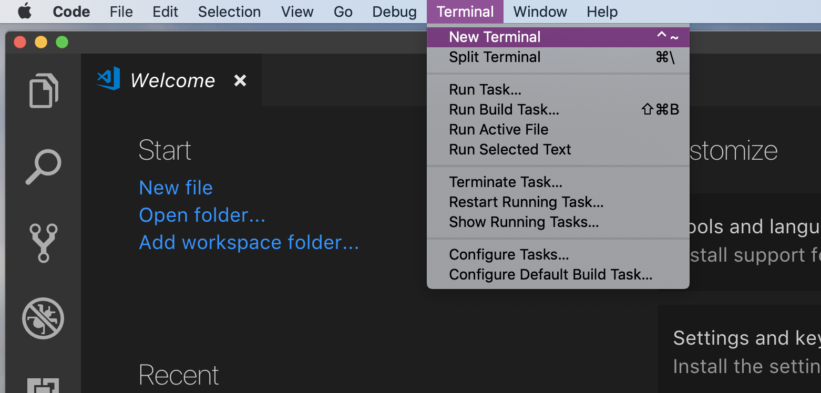
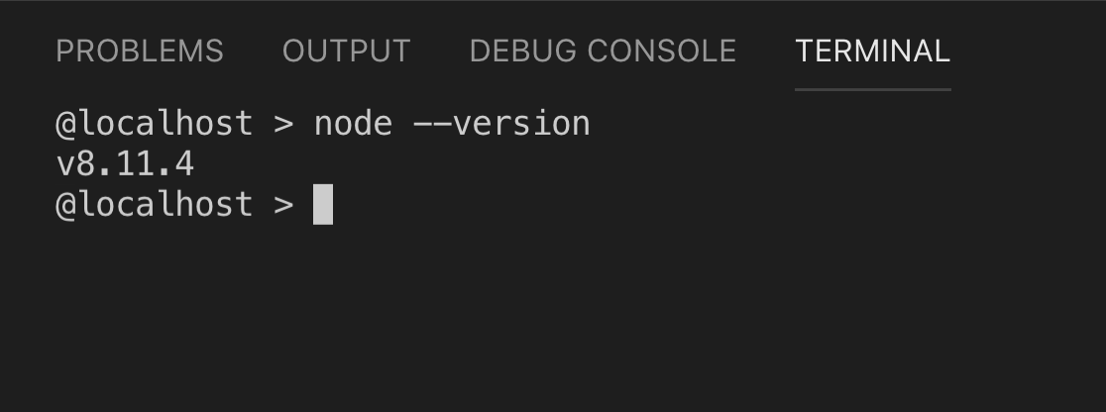
Check Node.js Installation
Instructions
Open Visual Studio Code
Select Terminal -> New Terminal.
Type node --version in your terminal. Note: You MUST be running an 8.x version of Node. If you are running any other major release, the app won't work!

Slide 32
Node Version Manager: Optional
If you are having difficulty installing/using Node version 8.x, follow the steps below.
Instructions
Install Node Version Manager (nvm). You can find it at https://github.com/creationix/nvm for Mac or https://github.com/coreybutler/nvm-windows for Windows.
Follow the installation instructions for your operating system.
In the terminal in Visual Studio Code, enter nvm install 8.11. This installs the correct version of node.
Then, enter nvm use 8.11. This tells your computer which version of node to use. This will solve this problem!
Notes:
We actually mean “nvm” NOT “npm”

Slide 33

Hello, Express!
Express is a very simple web framework for Node.js.
2 lines of code allow you to use Express in any JavaScript app!
Express makes it easy to handle app↔server communication via HTTP, such as get and post requests.
We won't install Express just yet; more on that later.

Slide 34
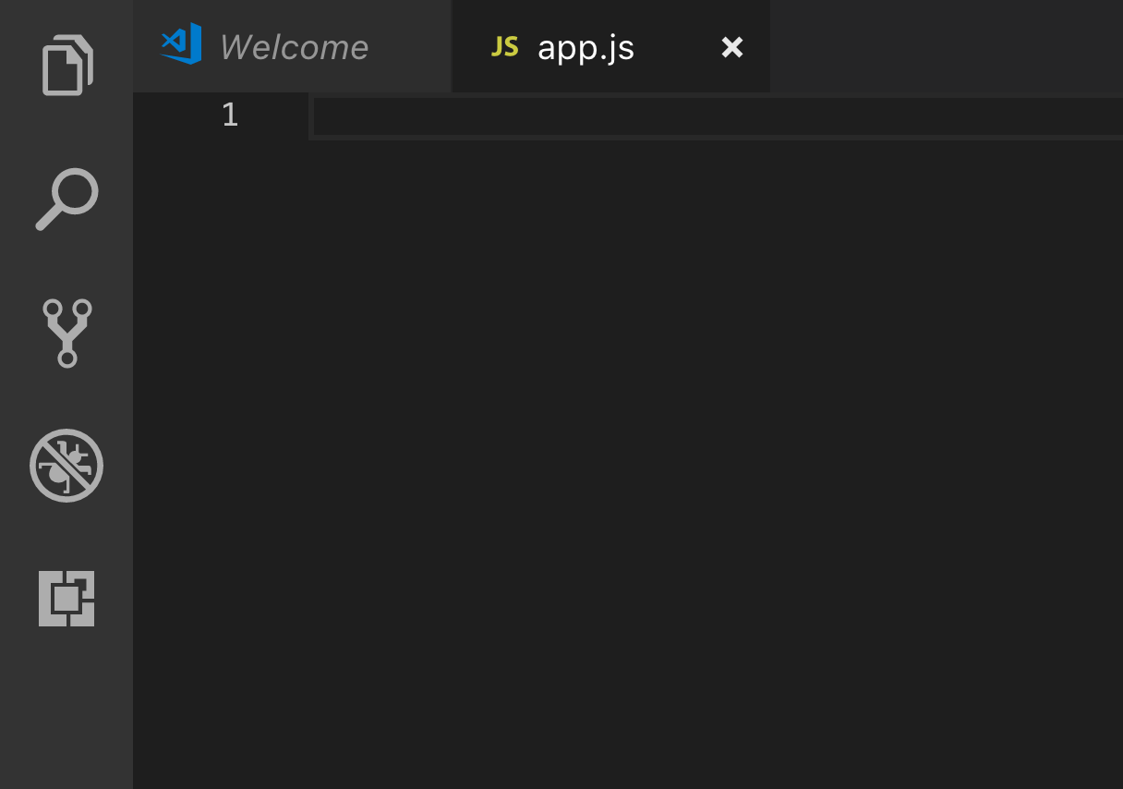
Hello, World!
Now that you have a basic understanding of Node and Express, let's develop the simplest app we can to get some experience.
Return to Visual Studio Code.
Click File -> New File.
Save your file as app.js.
Instructions
Notes:
Note the actual steps are numbered, while the informational text is not numbered.

Slide 35
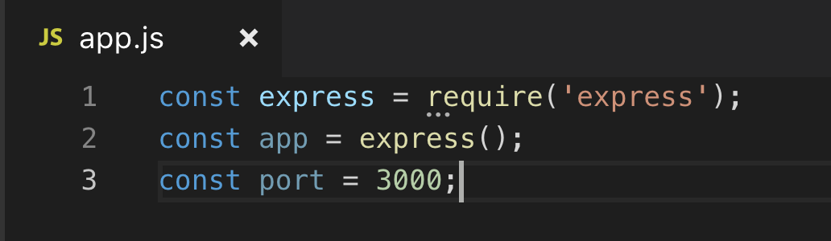
Hello, World!
Instructions
Add the following code to the file:
What does this code mean?
Line 1: Allows our file to use the Express package
Line 2: Creates a new express app
Line 3: Saves 3000 as the local port on which we'll later run the app

Slide 36
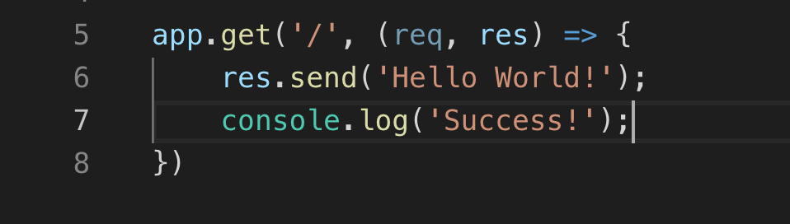
Hello, World!
Instructions
Add the following code to the file:
What does this code mean?
Line 5: Call the .get() method on our app. '/' refers to the app home page (usually index.html). When someone requests the home page of our app, do the following with the request (req) and response code (res):
Line 6: Use the .send() method to send Hello World! as the response.
Line 7: Print Success in the console.
Notes:
HTTP is how most computers talk to each other on the web. It has a bunch of “methods”, like “get, post, put”. We’re only going to focus on “get” (get something from ther server) and “post” (post something to the client)
There are MANY response codes for HTTP. But the most basic ones are:
200 → success
404→ page not found
403 → you don’t have permission to see that page

Slide 37
Hello, World!
What does this code do?
This block of code is called a route handler.
A route handler requires a method – .get() – and a route – '/'
A route handler also takes a callback function to tell the app what to do with the request and response
Notes:
Note: this code is hilariously inconsistent with semi-colons, because they basically don’t matter in JavaScript.

Slide 38
Hello, World!
Instructions
Add the following code to the file:
What does this code mean?
Line 10: On the local port that we saved earlier, listen for requests. Log Example app listening on port 3000! to the console.
Now let's run our app!
Notes:
The quotes in this slide are not quotes! They are backticks! ```

Slide 39
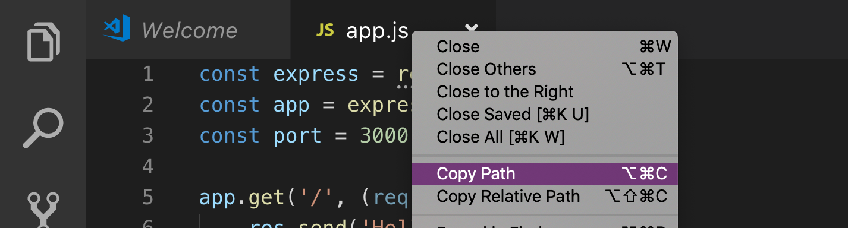
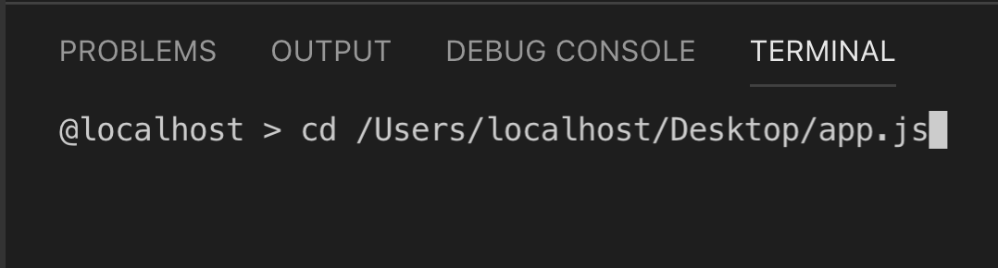
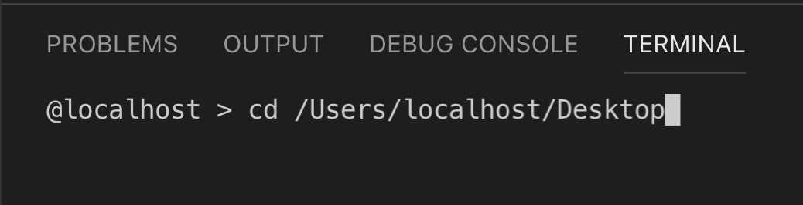
Hello, World!
Instructions
Right click app.js and select Copy Path.
In your terminal, type cd and paste the path you just copied.
Delete app.js from the end. Then, press [Enter].
Notes:
“cd” stands for “change directory”. Note: if you’re on Windows, your back-slashes might be reversed.

Slide 40
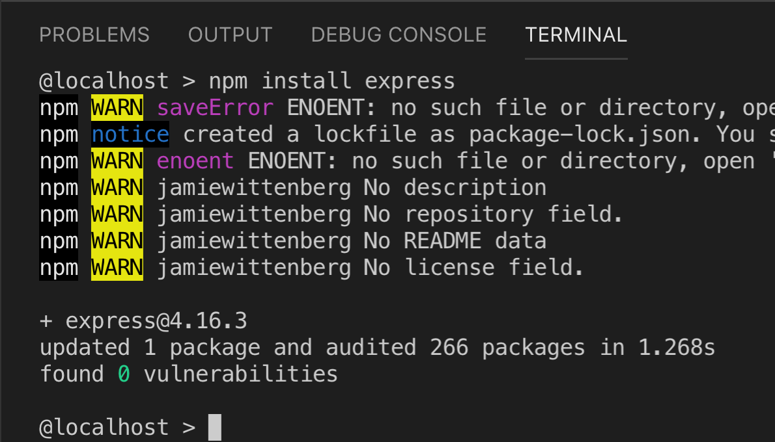
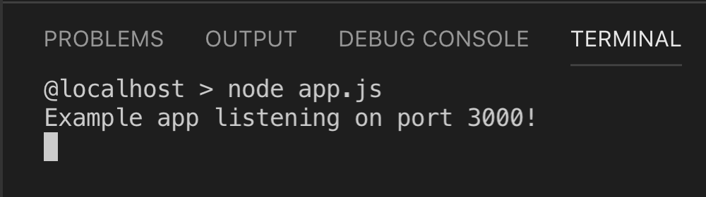
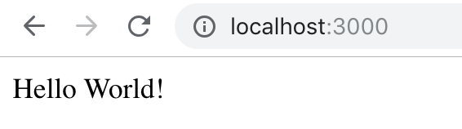
Hello, World!
Instructions
Type npm install express so that we can use Express on our computer.
Type node app.js to run our file.
Visit localhost:3000 in your browser.
Go back to your terminal. What's changed?
Enter [CTRL C] to kill the server.

Slide 41
Express.js
In that simple app, you created a route handler using the .get() method. You also used .listen(). Let's learn two more, .post() and .redirect()!
.post()
An HTTP method allowing the app to update information in the app's database based on information sent from the user
It requires the path of the route and a callback function.
.redirect()
Tells the app to send the user to another page. In our app, we'll use it to return the home page to the user after they submit an update, or return an error page if something is wrong
It requires the endpoint of the page you want to redirect to as a string

Slide 42
Node.js creates a the server for your app, and Express handles the requests and responses. The information in those requests and responses needs to be saved to a database. Let's learn about how this app achieves that!

Slide 43

MongoDB and Mongoose
We won't cover MongoDB and Mongoose in depth in this workshop, but here's what you need to know:
mongoose
mongoDB is a non-relational database
The updates that users post to our app will be stored in a mongoDB database
Instead of installing MongoDB, we'll use a hosted version of it on Microsoft Azure
mongoose is a framework for structuring data in a mongoDB database.
Notes:
You don’t need to use MongoDB for this application. There’s no reason it’s particularly suitable for it. However, it’s popular, so it’s what we’re using.

Slide 44
Now you have experience with Node.js and Express and a base level understanding of MongoDB and Mongoose.
Let's download our project!

Slide 45
Download the Hacker Log Starter Code
Instructions
http://mlhlocal.host/azure-web-code
Navigate to the URL above.
A zip file of the code will be downloaded. Note: This is only a download. No webpage will load.
We need to unzip the file and open it in Visual Studio Code. These steps are different for MacOS and Windows – please follow the next steps very carefully depending on your operating system!
Notes:
You can also just open the folder in Visual Studio Code. However, only try this if you’re confused by the other steps.

Slide 46
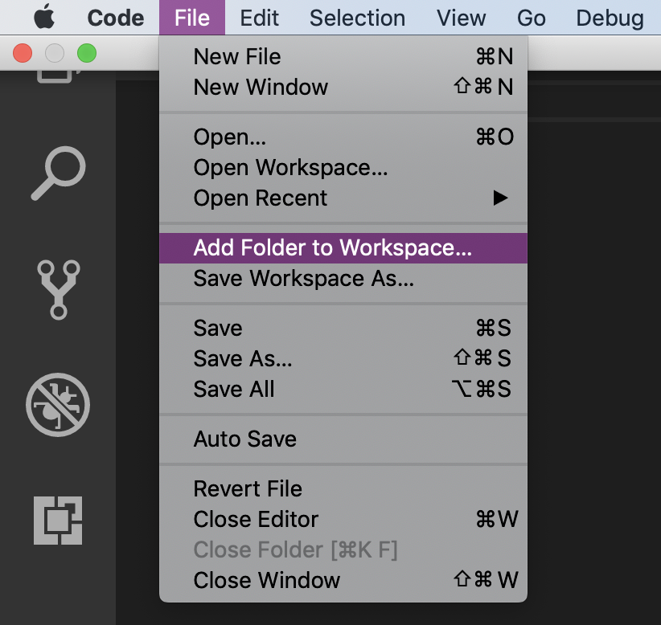
Add Project to Visual Studio Code: MacOS
Click the downloaded zip file. It will be automatically unzipped.
In Visual Studio Code, Click File -> Add Folder to Workspace.
Instructions

Slide 47
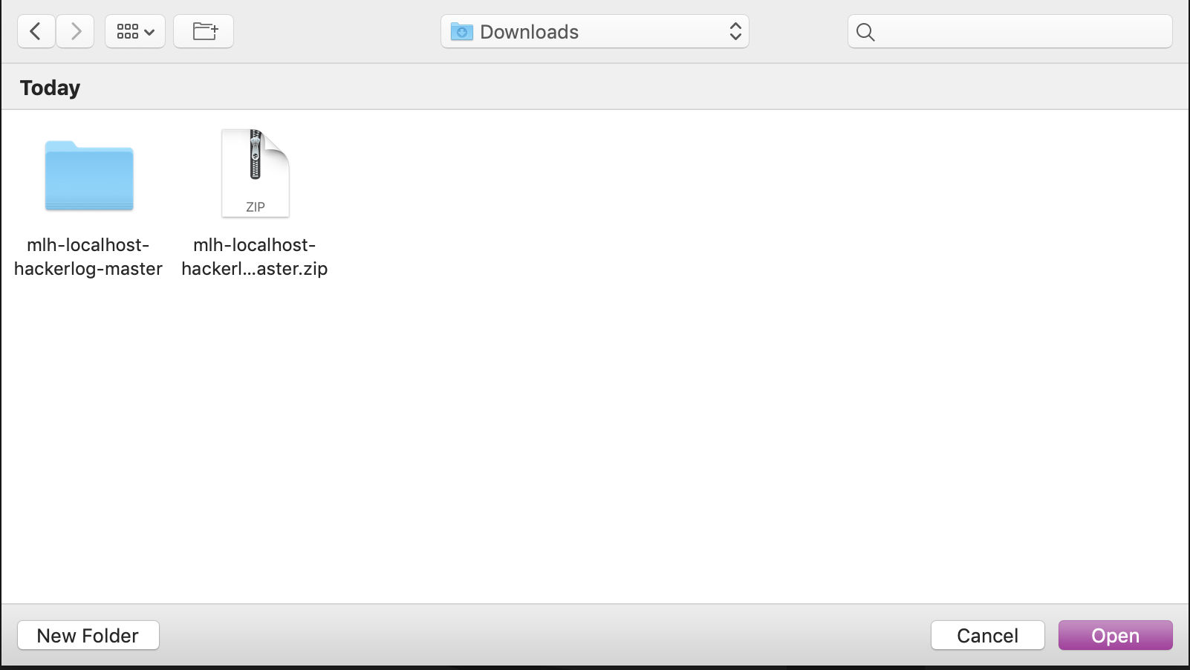
Add Project to Visual Studio Code: MacOS
Instructions
In the file navigator modal, navigate to Downloads.
Select mlh-localhost-hackerlog-master.
Select Add.

Slide 48
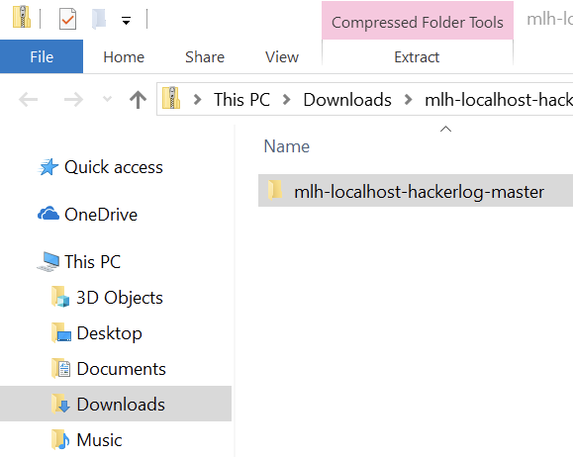
Add Project to Visual Studio Code: Windows
On a Windows computer, open the Downloads folder.
Select mlh-localhost-hackerlog-master.
Select Extract at the top.
Select Extract All.

Slide 49
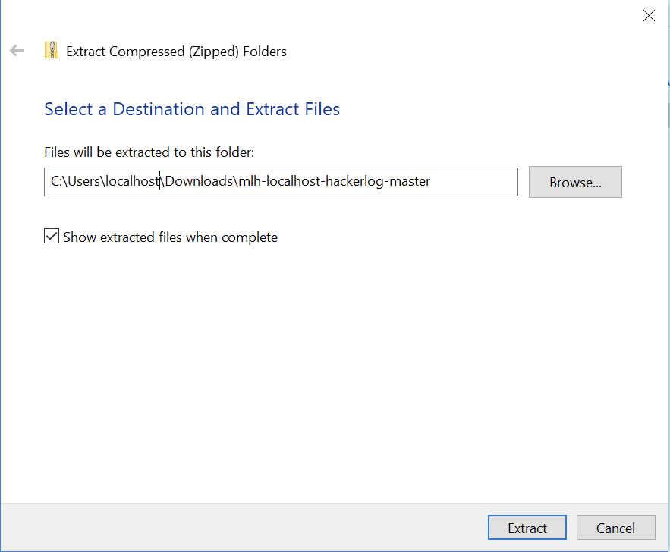
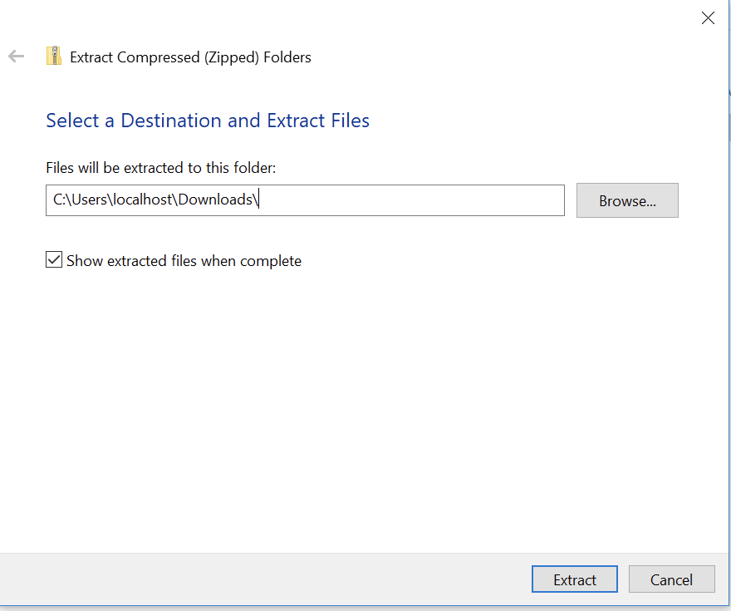
Add Project to Visual Studio Code: Windows
This screen will pop up. Delete mlh-localhost-hackerlog-master from the end of the file name. Select Extract.

Slide 50
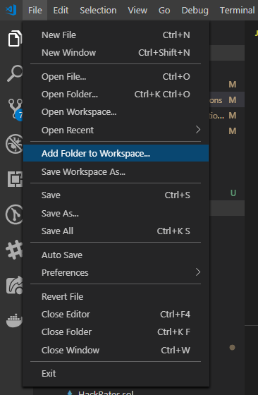
Add Project to Visual Studio Code: Windows
In Visual Studio Code, Click File -> Add Folder to Workspace.
Instructions

Slide 51
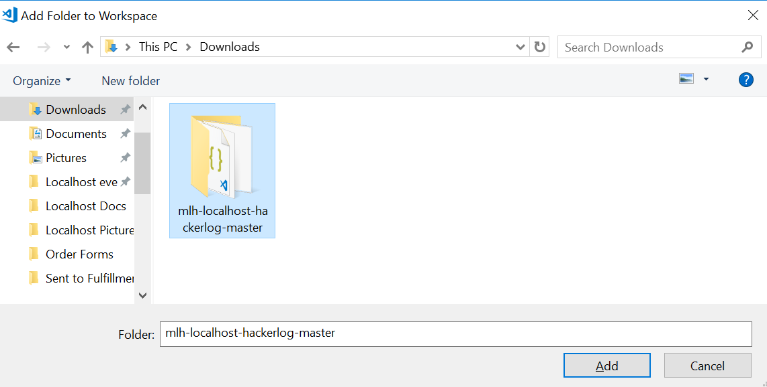
Add Project to Visual Studio Code: Windows
Instructions
In the file navigator modal, navigate to Downloads.
Select mlh-localhost-hackerlog-master.
Select Add.

Slide 52
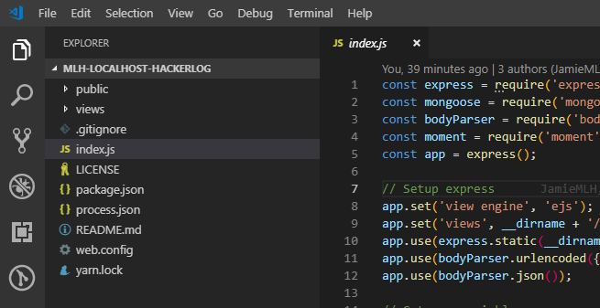
Add Project to Visual Studio Code
On both Mac and PC, Visual Studio Code looks like this:

Slide 53
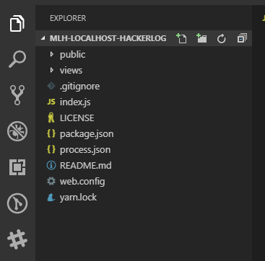
What's in this project?
What are these files?
public/ – this directory contains files for the browser to display your web app, such as CSS and fonts
views/index.ejs – an Embedded JavaScript file, the main landing page of our app

Slide 54
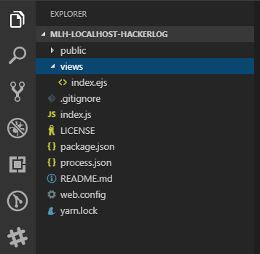
What's in this project?
What are these files?
index.js - this file does the hard work of our app; it tells the app how to handle requests and connect to the database
package.json - this file tells the project all of the necessary node packages for the app to run

Slide 55
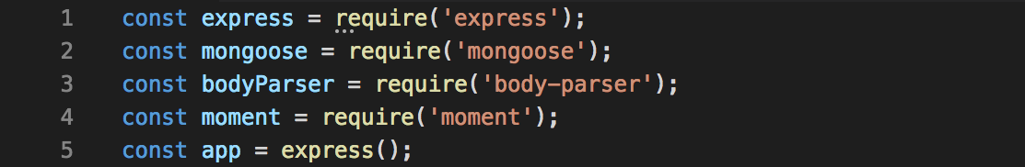
Code Review
Open index.js in Visual Studio Code and let's review!
index.js
Lines 1 - 4 allow the app to use the listed Node packages.
Line 5 creates an Express app, which will handle routing, or how the app receives and sends information

Slide 56
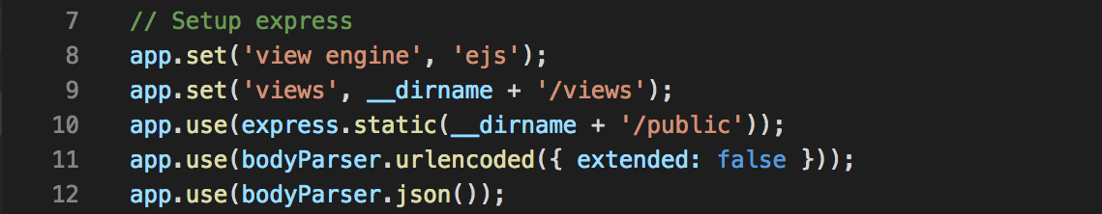
Code Review
index.js
Lines 8 - 12 tell the Express app where to find and how to use the files for view rendering and presentation, as well as how to read communication from the browser

Slide 57
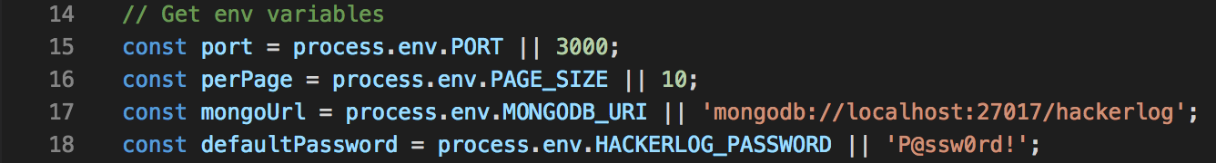
Code Review
index.js
Lines 15 - 18 tell the app to retrieve environment variables (env) from where the app is being run. If no environment variable is available, it sets it to a default value (the value to the right of the || pipes).
Line 18 contains the default password, which you can change.

Slide 58
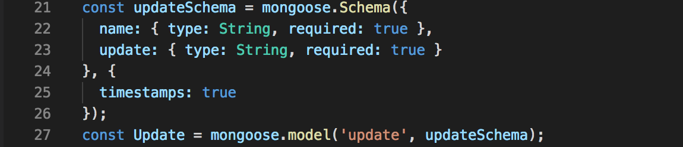
Code Review
index.js
Line 21 saves the process of creating a schema (structure/format of data) into a variable called updateSchema.
Lines 22 - 23 create a schema (a blueprint for entries in a database) with the information submitted to the form on the HackerLog app
Line 27 saves the process of adding a new entry to the database to a variable called Update.

Slide 59
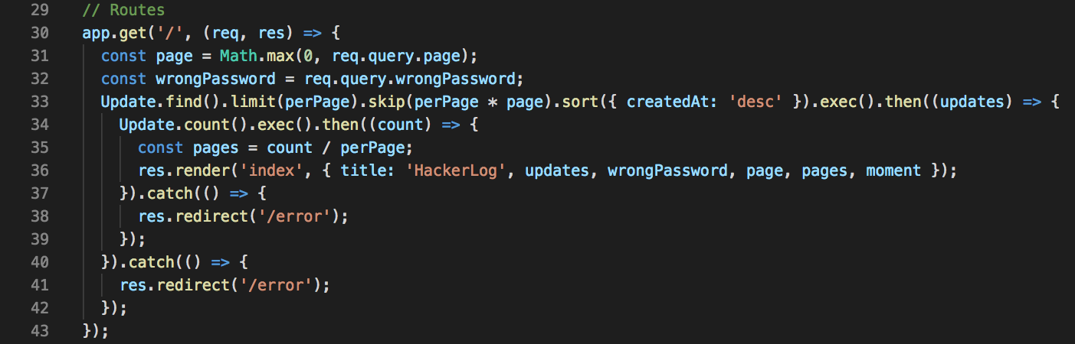
Code Review
index.js
Line 30 tells the app that when the URL for the webpage is entered, the app should run the code that comes after the open bracket ( { ) at the end of the line (and before the closing bracket ( } ) on line 43), and what to do with the request (req) and the response (res)

Slide 60
Code Review
index.js
Lines 33 - 36 tell the app to retrieve data from the database, calculate how many pages to display (10 entries per page), and render the data on the page

Slide 61
Code Review
index.js
Lines 37 - 42 handle any errors in the process by taking the user to the error page

Slide 62
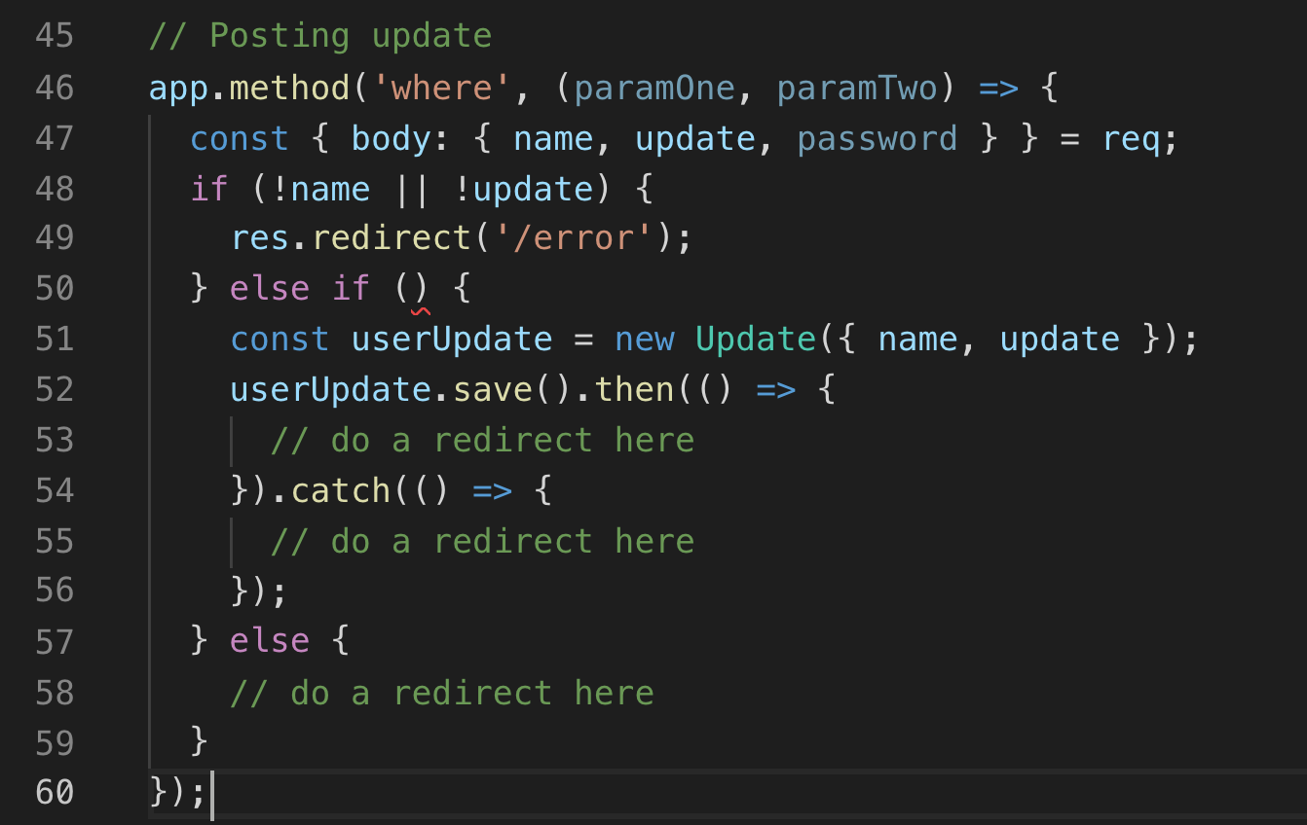
Code Review
index.js
You'll write the code for these later!
We'll come back to lines 46 - 60, since you'll be filling in some of it!

Slide 63
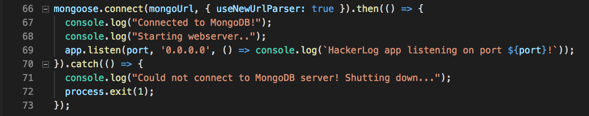
Code Review
index.js
Line 66 connects the app to the mongo database, then:
Lines 67 and 68 log success messages onto the console
Line 69 starts the app using Node
Lines 70 - 73 handles any errors that may occur

Slide 64
Index.js handles the requests our app receives and the responses that it sends. These requests come from the browser and are entered into index.ejs. These are two different files! The result is HTML to send back to the browser.

Slide 65
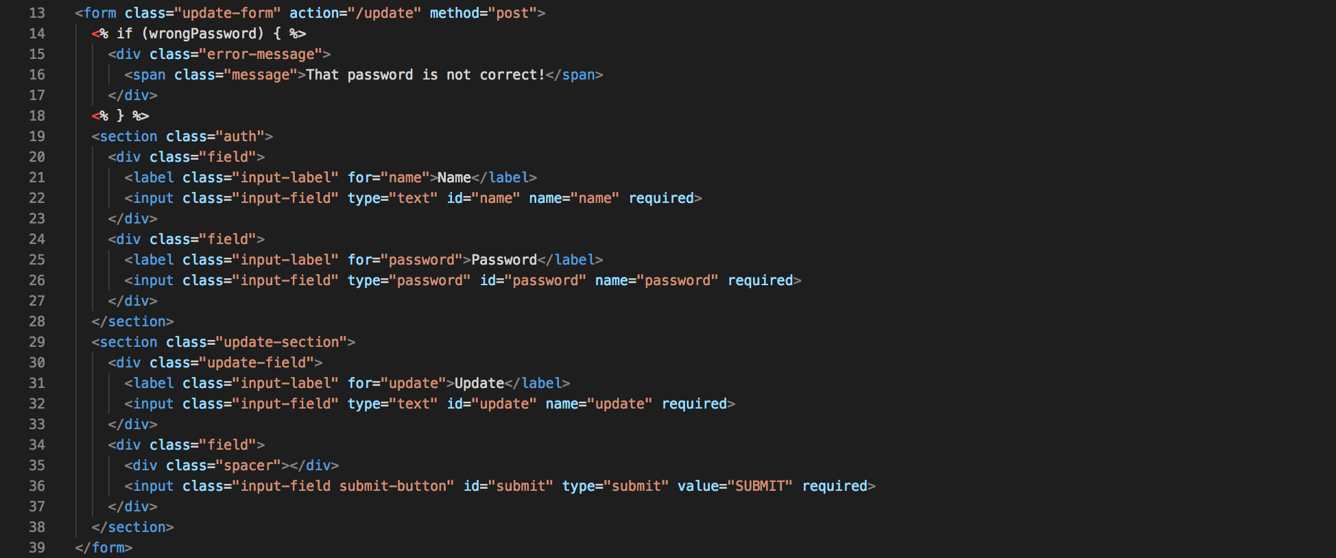
Code Review
index.ejs
Lines 13-39 create the form that you see on the app
Note:
This file is dense, so we'll only be touching on the code that is critical for our purposes!

Slide 66
Code Review
index.ejs
Line 13 has a method attribute with the value “post”. This means that when someone submits the form, it sends a post request to the app. It also has an action attribute with the value “/update”. This is how we separate the different kinds of requests.

Slide 67
Code Review
index.ejs
Lines 14 - 18 post an error message if the wrong password is submitted.

Slide 68
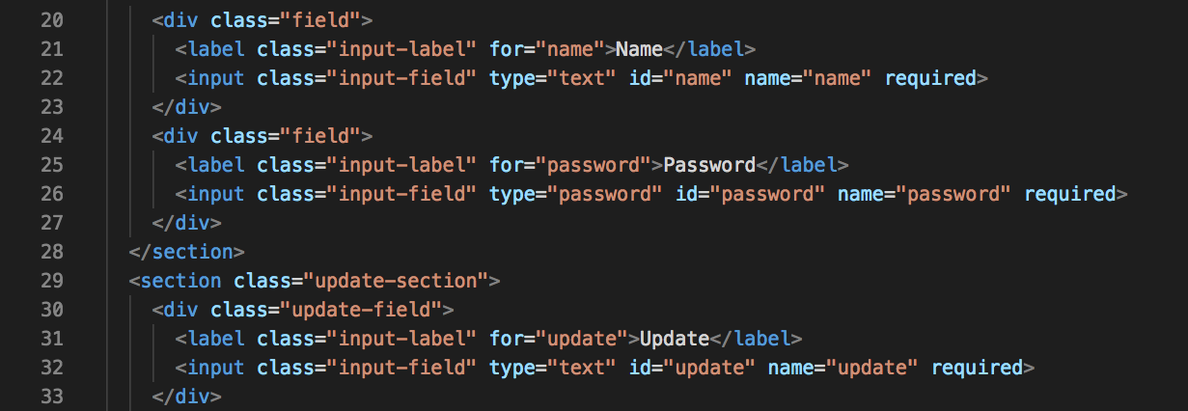
Code Review
index.ejs
Lines 20 - 23 create the name field on the form.
Lines 24 - 28 create the password field on the form. The name attributes in this section are used to form the database schema in index.js
Lines 29 - 33 create the update field on the form.

Slide 69
Now that you understand the code that's written in the app, let's write the missing code!

Slide 70
Your Turn!
Let's go back to lines 46 - 60 in index.js. You're going to fill in the incomplete event handler under // Posting Update!
index.js

Slide 71
Your Turn!
index.js
Lines 46 - 60
This function should be able to:
1
Line 46 sends a post request. paramOne and paramTwo are the wrong words.
2
On line 46, the request should go to '/update'.
3
Line 50 verifies that the password the user enters matches defaultPassword.
4
Line 53 should call the redirect method on the res and redirect the user to '/'.
5
Line 55 should call the redirect method on the res and redirect the user to '/error'.
6
Line 58 should call the redirect method on the res and redirect the user to '/?wrongPassword=true'.
Notes:
?wrongPassword=true is a way of passing a parameter to ejs

Slide 72
Want to test your code before you see the solution?
Save your changes by clicking File > Save or [ Command ] + S.
Close the terminal you had open from testing app.js.
Open the Integrated Terminal by clicking View > Terminal. Closing and opening the terminal will ensure you are in the correct directory.
Install the app dependencies with npm install.
Run the program with node index.js
Open a browser and visit the URL http://localhost:3000
If your app isn't working, type [CTRL] + C to stop it, try to fix it and start it again with node index.js!
Notes:
Remember, the terminal is

Slide 73
Are you ready to see if you did it?

Slide 74
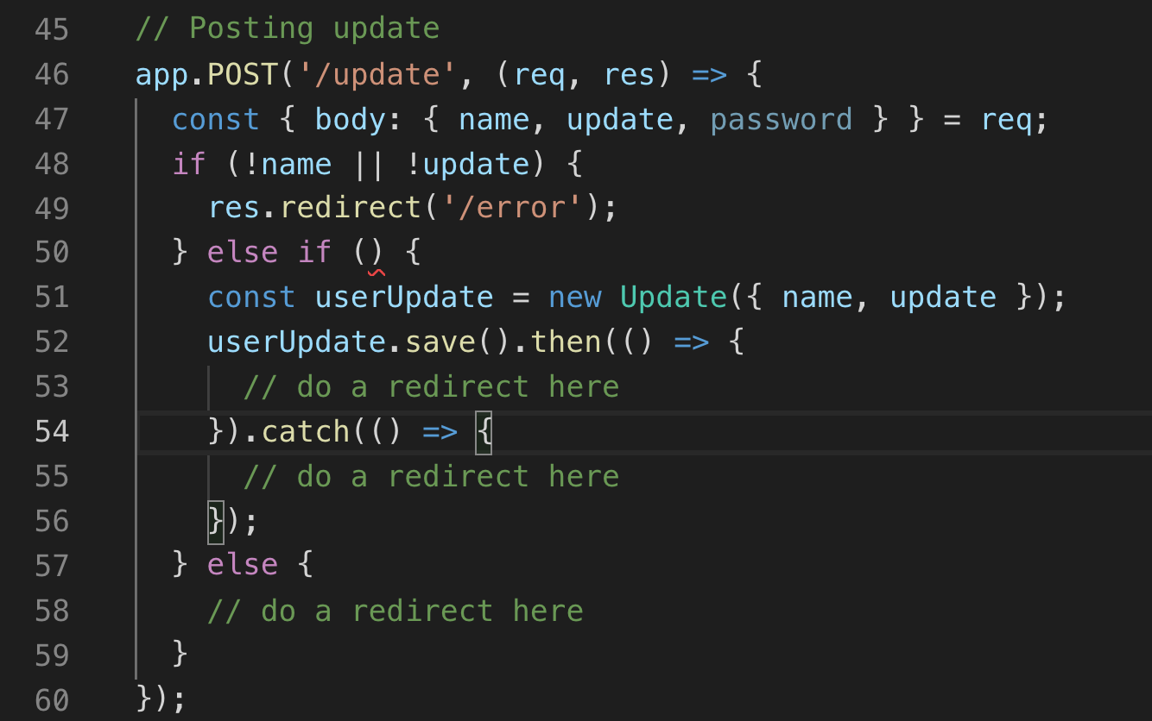
Your Turn - Write the POST Function
1
Send a post request.
2
The request should go to '/update'
3
Line 50 should make sure the password is correct.
index.js

Slide 75
Your Turn - Write the POST Function
1
Send a post request.
2
The request should go to '/update' instead of '/'.
3
Line 50 should make sure the password is correct.
index.js

Slide 76
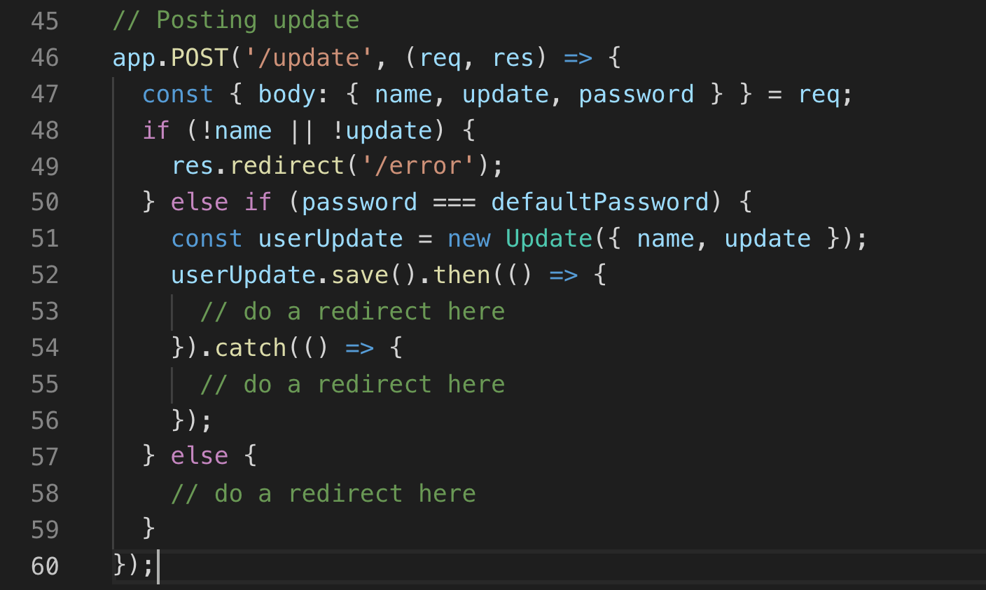
Your Turn - Write the POST Function
1
Send a post request.
2
The request should go to'/update' instead of '/'.
3
Line 50 should make sure the password is correct.
index.js

Slide 77
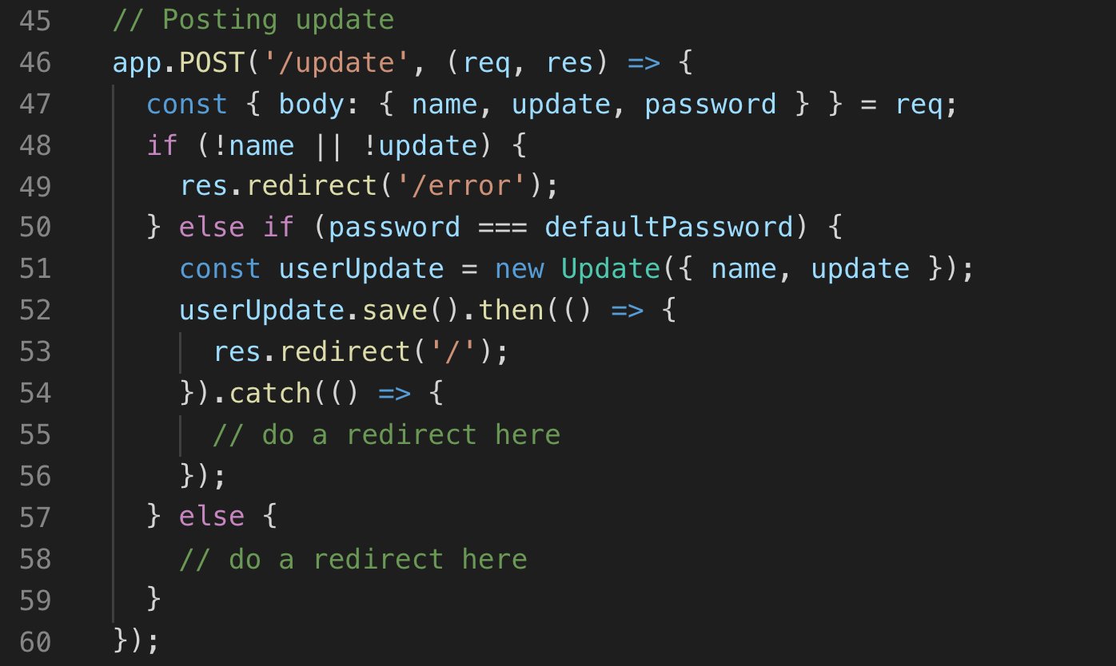
Your Turn - Write the POST Function
index.js
4
Line 53 should call the redirect method on the res and redirect the user to '/'.
5
Line 55 should call the redirect method on the res and redirect the user to '/error'.
6
Line 58 should call the redirect method on the res and redirect the user to '/?wrongPassword=true'.

Slide 78
Your Turn - Write the POST Function
index.js
4
Line 53 should call the redirect method on the res and redirect the user to '/'.
5
Line 55 should call the redirect method on the res and redirect the user to '/error'.
6
Line 58 should call the redirect method on the res and redirect the user to '/?wrongPassword=true'.

Slide 79
Your Turn - Write the POST Function
index.js
4
Line 53 should call the redirect method on the res and redirect the user to '/'.
5
Line 55 should call the redirect method on the res and redirect the user to '/error'.
6
Line 58 should call the redirect method on the res and redirect the user to '/?wrongPassword=true'.

Slide 80
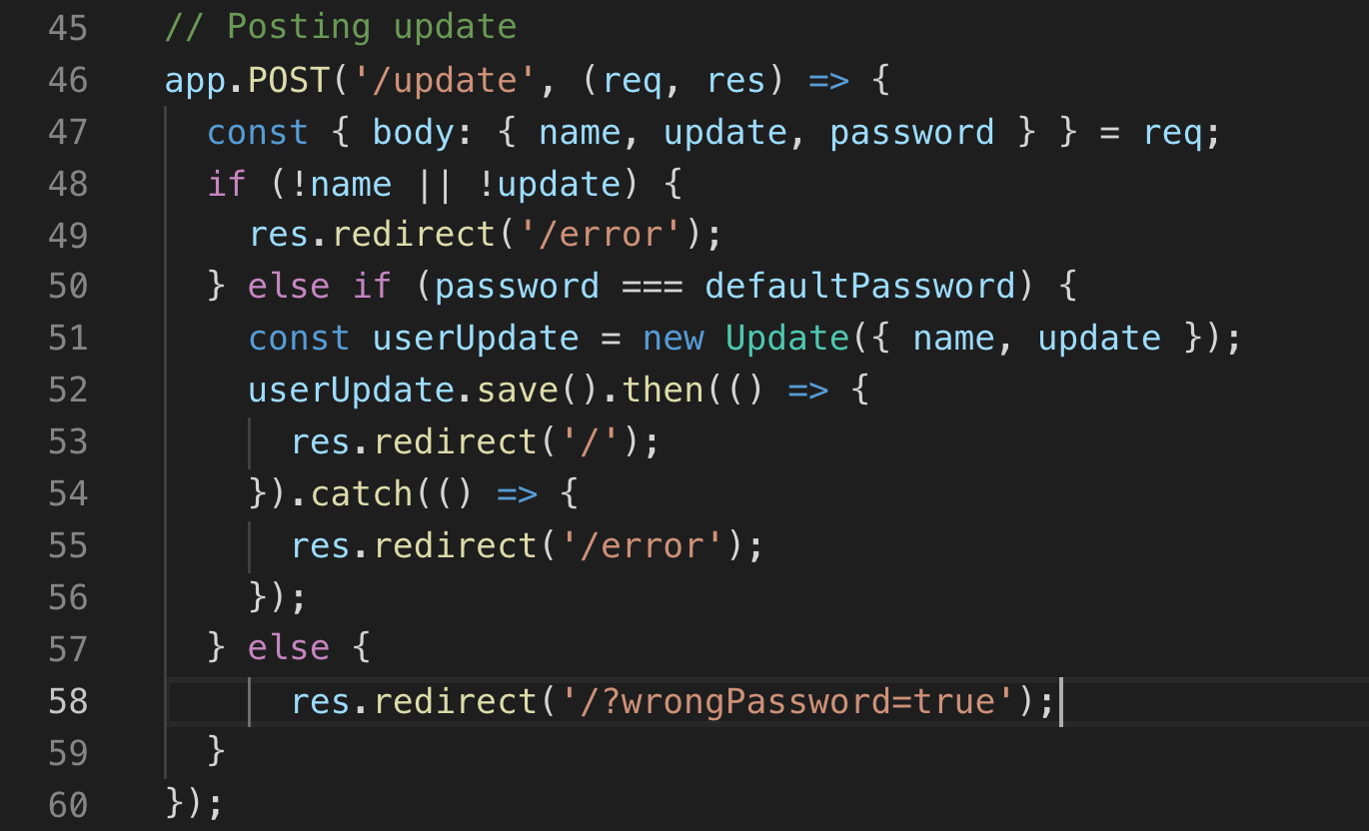
Our Code is Complete!
Now that our code is complete, let's try running our app again!
index.js

Slide 81

Try it One More Time!
Type node index.js in your terminal.
Visit localhost:3000 in the browser!

Slide 82
Amazing! You've learned about Node and Express, written code, and tested your app. Now, let's deploy it so others can use it!

Slide 84

Create a Cosmos Resource
First, we'll create our database on Azure.
Instructions
Navigate to your Azure dashboard and select Create a Resource then search for and select Azure Cosmos DB. Click Create.
Notes:
It takes a lot of steps to get some resources in the cloud configured to run our app. However, this is much easier than setting up your own server. Additionally, even if you really don’t care about most of these settings for your simple app, large companies need these concepts, such as “resource group” and “virtual private network”.

Slide 85

Create a Cosmos Resource
Instructions
Select your subscription.
Select Create new under Resource Group. Resource Groups are a way of organizing all of your Azure projects.
Name your Resource Group. You'll add your app to this group later, too.
Select OK.

Slide 86

Create a Cosmos Resource
Instructions
Create an account name.
Select Azure Cosmos DB for MongoDB as the API.
Select your location.
Disable both options.
Select Next: Network.

Slide 87

Create a Cosmos Resource
Instructions
Click Create a new virtual network.
Name it HackerLogVN.
Select OK.
Click Review + create

Slide 88


Create a Cosmos Resource
Instructions
Click Create and wait for your database to deploy!
It may take up to 10 minutes for your resource to be deployed. When it's done, select Go to resource.
Notes:
If this step fails with the error “Conflict”, you can click “redeploy” to try again and it should resolve itself.

Slide 89

Create a Cosmos Resource
Instructions
Open the Connection String menu, under the Settings category.
Copy PRIMARY CONNECT STRING. You'll need it later.

Slide 90

Create a Cosmos Resource
Instructions
Go to the Firewall and virtual networks tab under the same Settings category.
For the purposes of this workshop, select All networks under Allow access from: (you wouldn't do this in a production app).
Save!
Notes:
We have a public app, so we want everyone to access it. If you were deploying something which should only be used by people inside a certain company, you would actually need to configure this.

Slide 91
Now that your database is set up, we'll create something called an App Service Plan.

Slide 92


Create an App Service Plan
Return to portal.azure.com
Select Create a Resource then search for "App Service Plan (Classic)".
Select App Service Plan then select Create in the panel that opens.

Slide 93

Create an App Service Plan
Instructions
In the panel that opens, name your service plan HackerLogPlan.
Select the Resource Group you made previously.
Select Linux as your operating system.
Select East US.
Select Pricing tier.

Slide 94


Create an App Service Plan
Instructions
Select Dev/Test.
Select B1.
Select Apply.
When the previous screen returns, select Create. Wait a minute or two for that to finish deploying, then we'll create the resource for the HackerLog Web App!

Slide 95
Finally, let's deploy!

Slide 96

Deploy Your App to Microsoft Azure
Instructions
Navigate to your Azure dashboard and select Create a resource then Web then Web App.

Slide 97

Deploy Your App to Microsoft Azure
Instructions
In the panel that opens, name your app something unique.
Select the Resource Group you made previously.
Select Linux as your operating system.
Select Node.js 10.10 as your Runtime Stack.
Click Create at the bottom of the screen.

Slide 98
Wait a moment for the app to deploy, then follow the next steps.

Slide 99

Deploy Your App to Microsoft Azure
Instructions
On the left side of your Azure portal, select All resources.
Click the App Service you just made.
Select Deployment Center.
Notes:
Yeah, the app name is a bit weird, but bear with us.

Slide 100

Deploy Your App to Microsoft Azure
Instructions
Scroll to select Local Git. Select Continue.

Slide 101

Deploy Your App to Microsoft Azure
Instructions
Select App Service Kudu build server then select Continue then Finish.

Slide 102

Deploy Your App to Microsoft Azure
Instructions
Select Deployment Credentials then User Credentials.
Create a Username and Password.
Notes:
As of 2019 February 15, Azure will create a password for you.

Slide 103

Deploy Your App to Microsoft Azure
Instructions
You will know the previous step was successful if you’ve received the popup notification.

Slide 104

Deploy Your App to Microsoft Azure
Instructions
Select Configuration.
Click + New application setting.
The name of the new setting is "MONGODB_URI"
The value of the new setting is the PRIMARY CONNECTION STRING you copied when you made the CosmosDB resource. This is how your app and the DB can talk to each other. It will look like this:
mongodb://<username>:<pimary_password>@<hostname>:<port>/?ssl=true&replicaSet=globaldb

Slide 105

Deploy Your App to Microsoft Azure
Instructions
This part is a little tricky, so please read very carefully. Towards the end of your connection string, after the / and before the ?, include the word admin.
Before:
mongodb://<username>:<pimary_password>@<hostname>:<port>/?ssl=true&replicaSet=globaldb
After:
mongodb://<username>:<pimary_password>@<hostname>:<port>/admin?ssl=true&replicaSet=globaldb

Slide 106
You just:
Created a database on Microsoft Azure.
Created an App Service Plan.
Created a Node app environment to deploy your app to.
Head back to Visual Studio Code for the rest!

Slide 107


Deploy Your App to Microsoft Azure
In Visual Studio Code, click the source control symbol.
Then, click the symbol next to SOURCE CONTROL.
Be sure that the folder is mlh-localhost-hackerlog-master and click it. Note: Make sure the folder is NOT your Desktop or entire Documents folder.

Slide 108


Deploy Your App to Microsoft Azure
Select Add to Workspace if prompted.
Type "First Commit" above CHANGES.
Click the checkmark.
Click Yes if you get a modal asking about staging changes.

Slide 109


Deploy Your App to Microsoft Azure
Return to your Azure portal. In your Deployment Center tab, copy the Git clone Uri.
In your terminal, type git remote add origin and paste what you just copied. This is how you tell Git where to send your code.

Slide 110


Deploy Your App to Microsoft Azure
Click the ellipses (. . .) near SOURCE CONTROL.
Select Publish Branch.
Enter the Password you created when prompted.
Notes:
The prompt is a pop-up in Windows

Slide 111

Deploy Your App to Microsoft Azure
Back in Azure Deployment Centre, you can see that your deploy is in progress!
Notes:
Or “Azure Deployment Center” if you are in the US

Slide 112

Deploy Your App to Microsoft Azure
When the build has finished, select Overview.
Click the URL for your web app, and try it live!

Slide 114
Let's recap quickly...
Node.js is a server-side JavaScript runtime ideal for high performance, scalable network applications.
1
Express is a Node.js framework for back end web development.
2
3
Developing Web Apps on Azure is fast.

Slide 115
What did you learn today?
We created a fun quiz to test your knowledge and see what you learned from this workshop.
http://mlhlocal.host/quiz

Slide 117
Keep Learning: Practice Problems for Later
Extra Practice Problem 1:
Add the password as an application setting and remove it from your code.
Extra Practice Problem 2:
Use the Azure Content Moderator to prevent people from posting negative content to your app!
Notes:
What to Say:
Read the slide.
What to Do:
Encourage participants to try these problems on their own.

Slide 118

Learning shouldn't stop when the workshop ends...
Check your email for access to:
These workshop slides
Practice problems to keep learning
Deeper dives into key topics
Instructions to join the community
More opportunities from MLH!
Notes:
What to Say:
What to Do:

Slide 119
v.0.0.1

